Slide 1
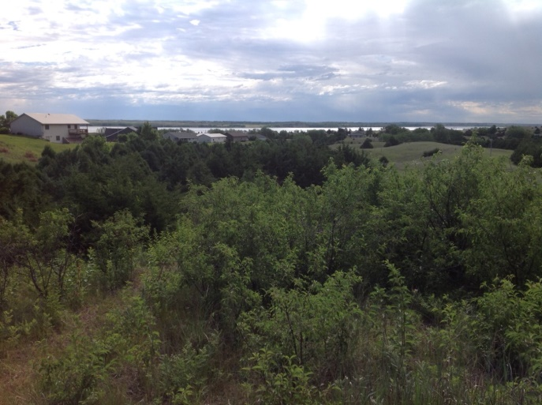
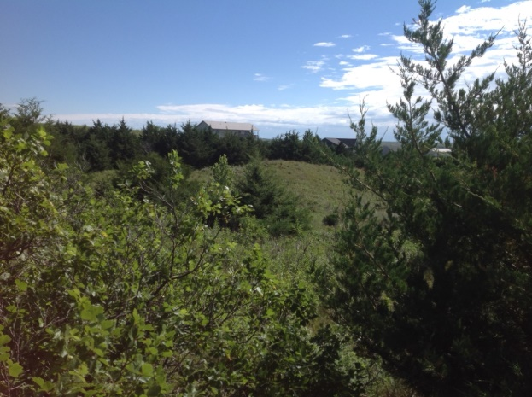
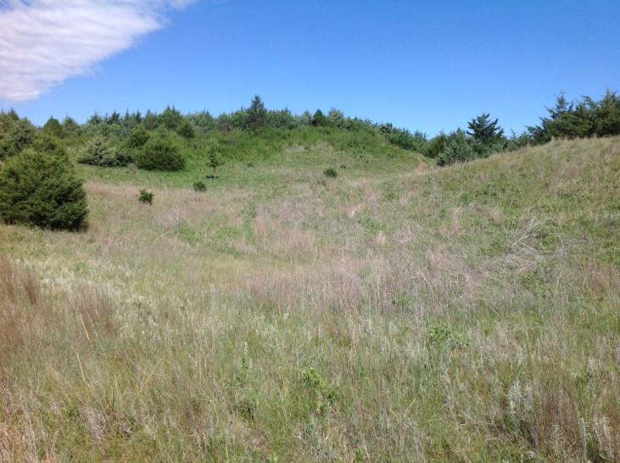
Here is an opportunity to purchase a lot at the Calamus Lake to build your dream home or get away cabin. The lot is back off of any main road and has views of the Calamus Lake and native Sandhills. There is access to electricity on the west boundary side of the property. Restrictive Covenants, Restrictions and Conditions available upon request.
1.39 Acre Lot, Aggies Acres - Calamus Lake, NE
Lot 5, Block G, Aggies Acres 3rd Subdivision
Loup County, Nebraska.
List Price: $40,000.00 Real Estate Taxes: 2020 - $336.38
Michele Usasz-Wells
Phone
308.750.0522
Email
michele.wells@cabinrealtyagservices.com
Website
cabinrealtyagservices.com

