Slide 1
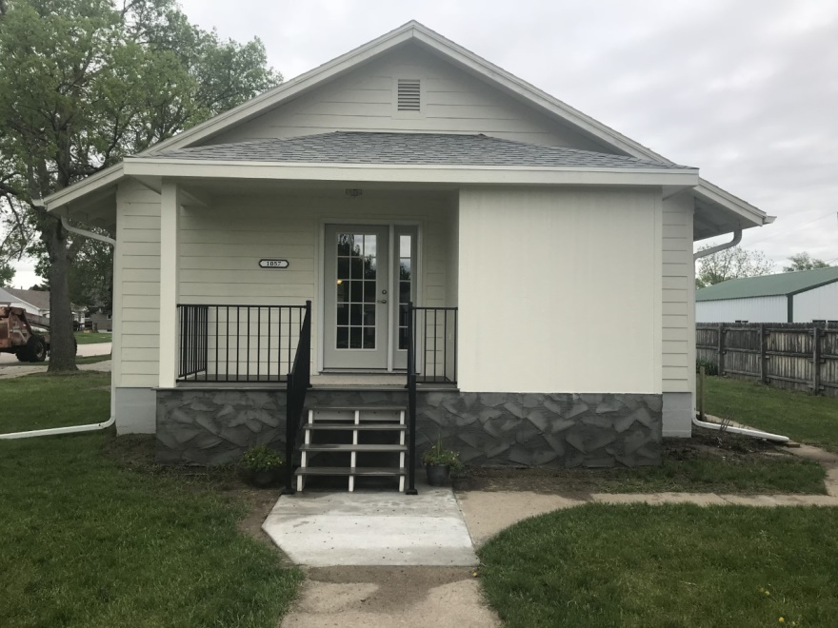
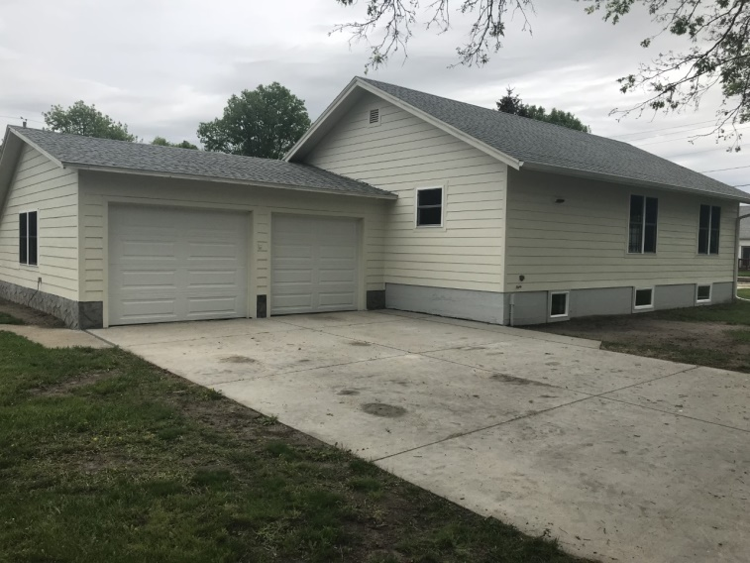
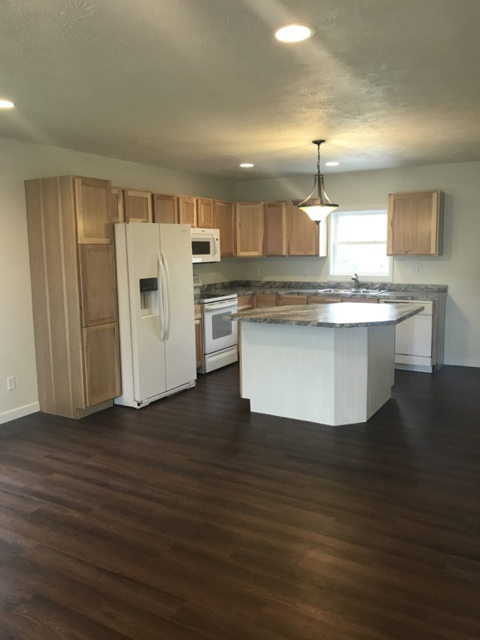
1057 G Street, Burwell, ne
Location:
This house is located west of the town square in Burwell.
Contact: Michele Usasz-Wells 308.750.0522
Comments:
This house has been updated with simple clean lines and functionality in mind. 1,028 sq feet on the main level, with an additional 988 sq feet in the partially finished basement. 3 bedrooms, 2 bathrooms with a 2 car attached garage.
Many updates that include but are not limited to - new windows, siding, flooring, paint, wiring and many doors. Appliances are included.

