Slide 1
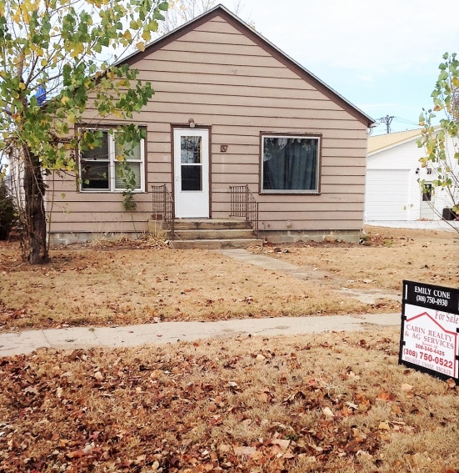
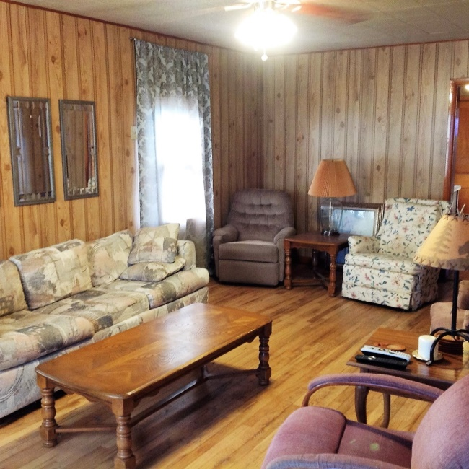
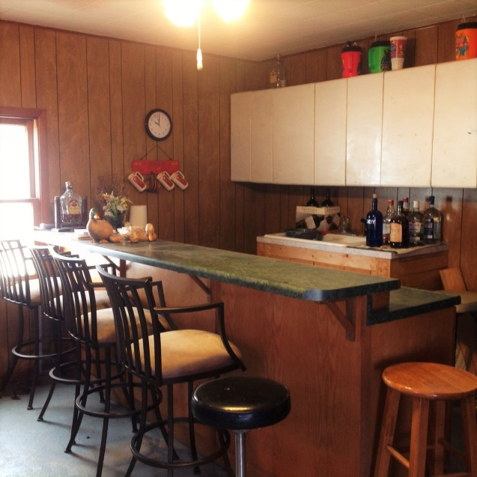
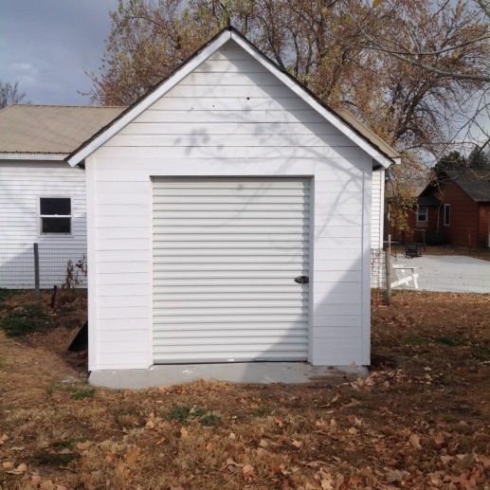
Legal Description: Lot 28, Block 7, Original City of Burwell List Price: $60,000.00 Real Estate Taxes: 2017 - $881.18 Contact: Erik Schwager: 308-750-0345 Comments: Excellent location, just off of the square! This 1,246 sq. ft., 2 bedroom, 2 bathroom home has a partially finished basement that has potential for additional bedrooms. Deck and new garden shed in the back. Brand new roof in 2017!
137 N 7th Ave., Burwell, NE
Price Reduced!
Cabin Realty & Ag Services
Real Estate Sale & Management
Michele Usasz, Broker
Terry K. Held, Associate Broker
Office: 308-346-4425
www. CabinRealtyAgServices.com

