Slide 1
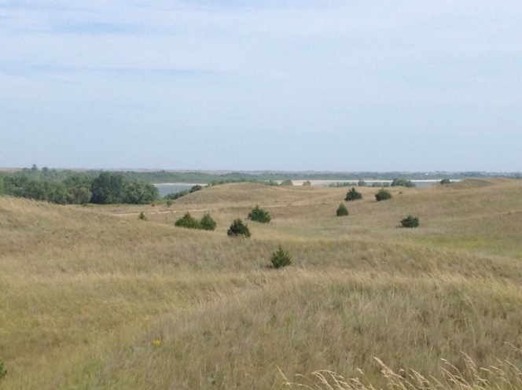
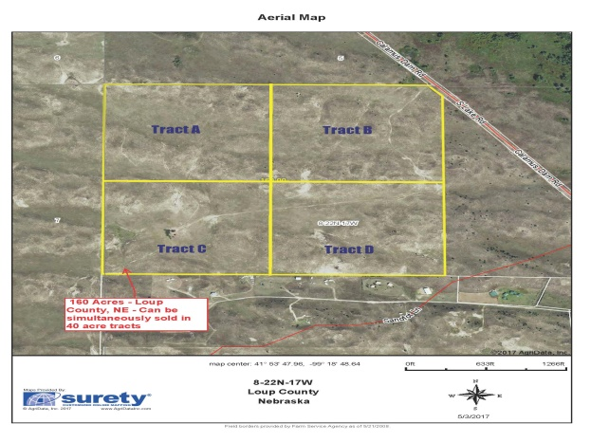
Legal Description: NW1/4 Section 8, Township 22N, Range 17W of the 6th P.M., Loup County, Nebraska. List Price: $400,000.00 Real Estate Taxes: 2017 - $960.56 Contact: Rick Foxworthy - 402.760.1100 Location/Description: Take Dam Road out of Burwell for approximately 5.5 miles northwest, turning left and crossing over the dam onto S. Lake Road for approximately 6 miles to the northeast corner of subject property marked by Cabin Realty & Ag Services signs Comments: Looking for a secluded get away with beautiful views of Calamus Lake, check this property out! This property could be divided into lots with electricity close by. There is income potential with 16 pair being ran for the grazing season, using one windmill.
160 Acres - Recreational Property, Near Calamus Lake - Loup County, NE
Cabin Realty & Ag Services
Real Estate Sale & Management
Michele Usasz, Broker
Terry K. Held, Associate Broker
Office: 308-346-4425
www. CabinRealtyAgServices.com

