Slide 1
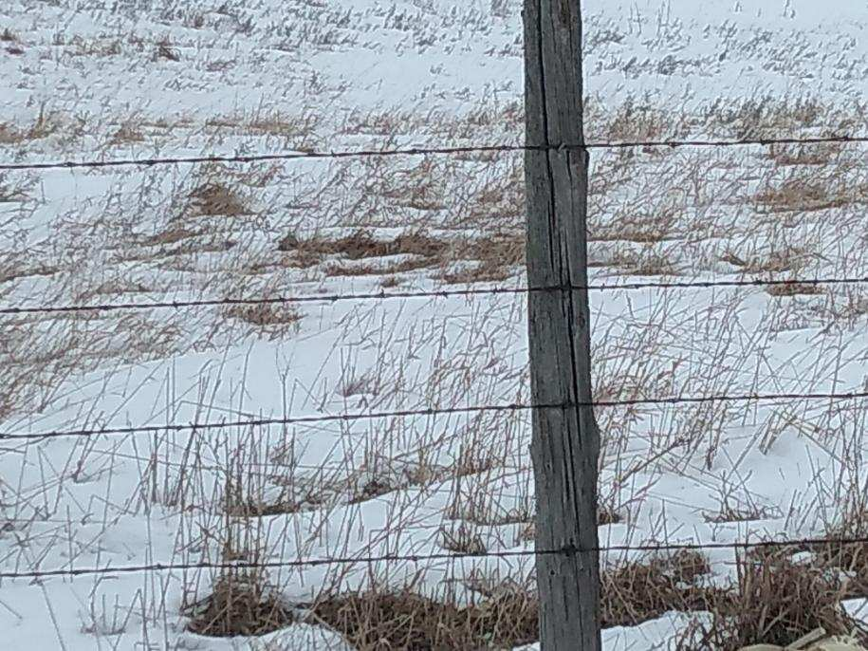
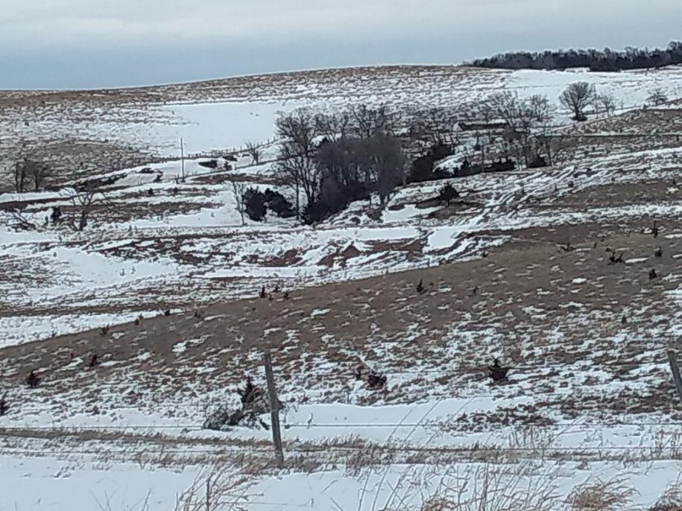
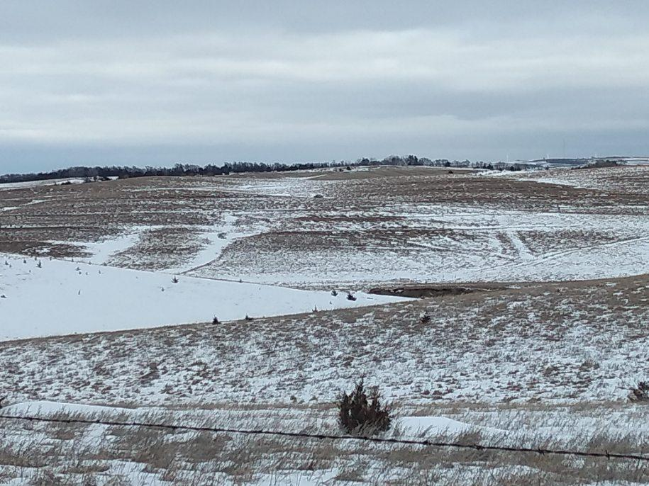
Investment Property, Potential Development, Knox County Hard Grass, Submersible Well, Recreational Opportunities! Mike Kumm 402-394-1118
160+ Acres Knox County, NE

