Slide 1
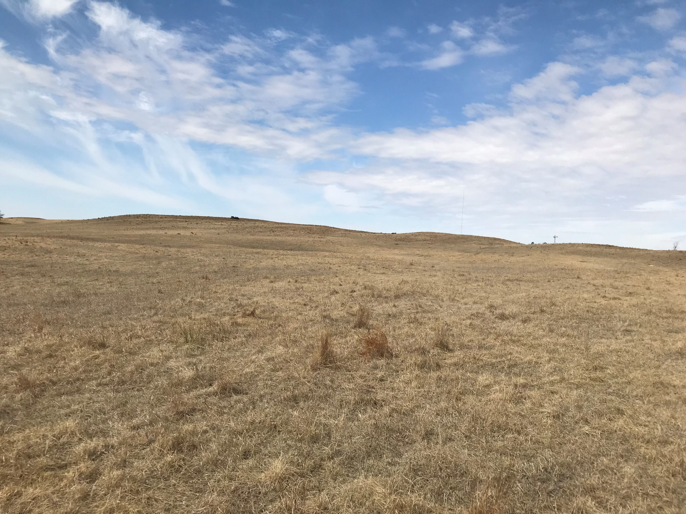
Legal Description:
S1/2 of the NW1/4 and N1/2 of the SW1/4 in Section 33, Township 23 N., Range 8 W. of the 6th P.M., Antelope County, NE.
Real Estate Taxes: 2017 - $1,155.20 Contact: Scott Wright 402.336.7501
Comments:
This sandhills pasture is divided into 2 grazing units with water placed to services both units equally. Cedar trees have been recently cleared to fully utilize the grazing acres. Carrying capacity has been 23-24 young pairs or 40 yearlings in past years. New 5 year CSP contract to be assumed by purchaser. Details available upon request.
Agent owned property.
Cabin Realty & Ag Services
Real Estate Sale & Management
Michele Usasz, Broker
Terry K. Held, Associate Broker
Office: 308-346-4425
www. CabinRealtyAgServices.com
160 +/- ACRES ALL GRASS UNIT
ANTELOPE COUNTY, NE

