Slide 1
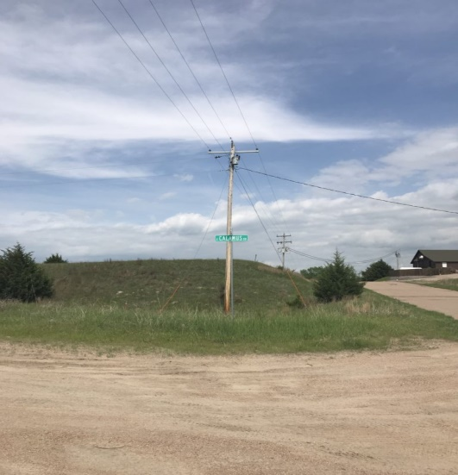
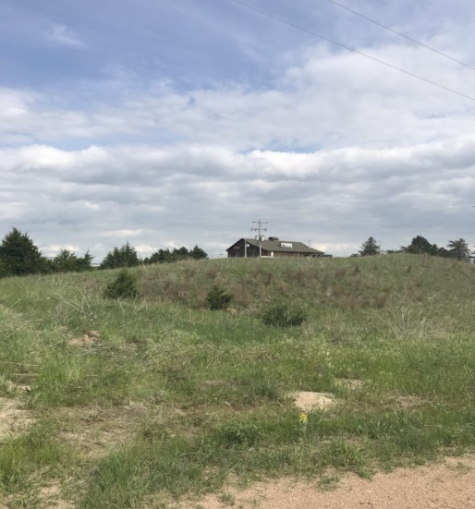
Location: Near Golf Course Burwell, NE Real Estate Taxes: 2017 - $237.92 Contact: Harvey Quiring - 308.750.0945 Comments: These lots are bare with no improvements and within walking distance to the Calamus Golf Course. Restrictive covenants are available upon request.
2 BARE LOTS
Calamus Country Acres
Cabin Realty & Ag Services
Real Estate Sale & Management
Michele Usasz, Broker
Terry K. Held, Associate Broker
Office: 308-346-4425
www. CabinRealtyAgServices.com

