Slide 1
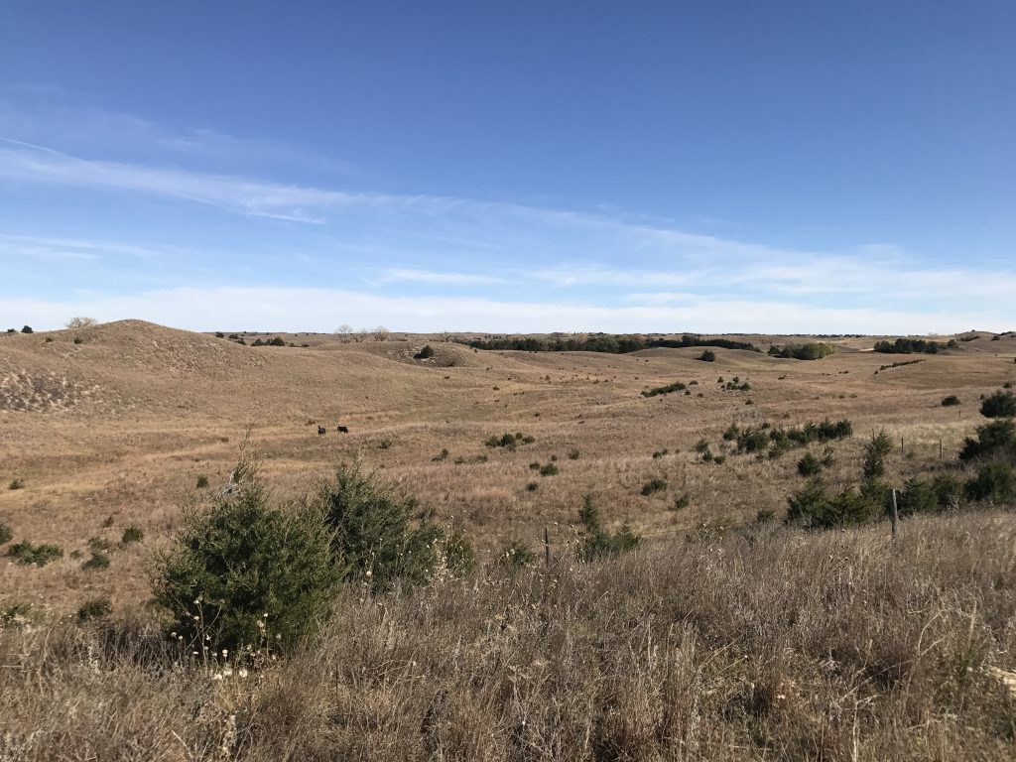
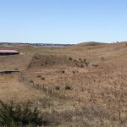
List Price: $30,000.00 Real Estate Taxes: 2017 $158.06 Contact: Michele Usasz 308.750.0522 These two lots are approximately 1.1 acres of native grasses with no improvements. Located off the beaten path and bordering range land on two sides of the property. Restrictive covenants are available upon request.
2 BARE LOTS
KRAUSE’S ADDITION TO CALAMUS COUNTRY ACRES – GARFIELD Co.
Cabin Realty & Ag Services
Real Estate Sale & Management
Michele Usasz, Broker
Terry K. Held, Associate Broker
Office: 308-346-4425
www. CabinRealtyAgServices.com

