Slide 1
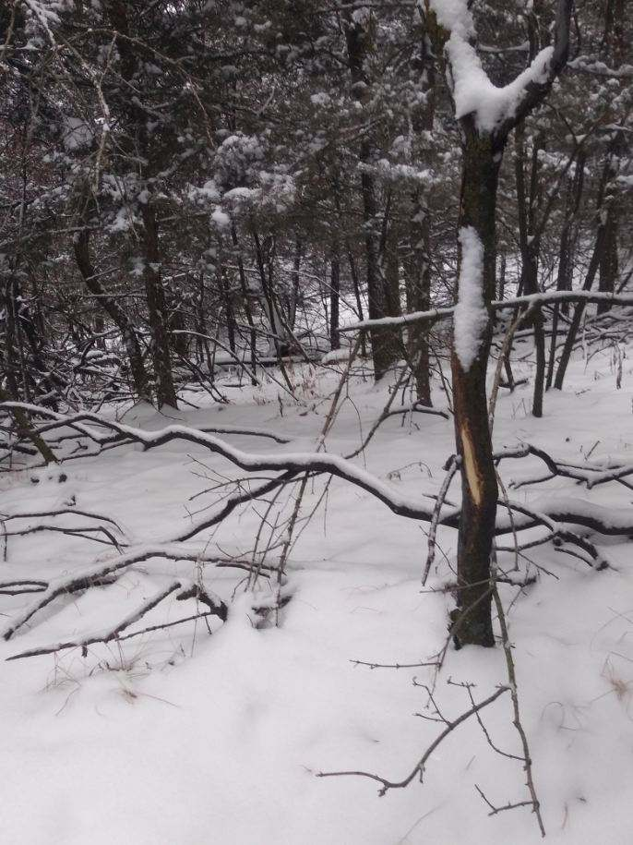
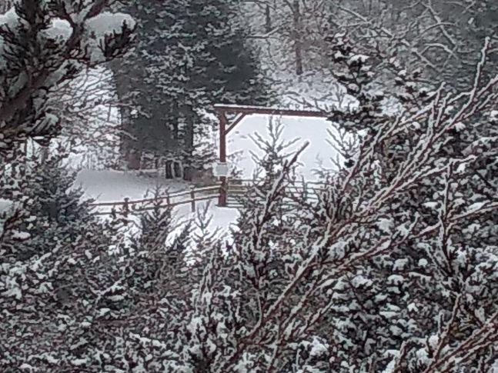
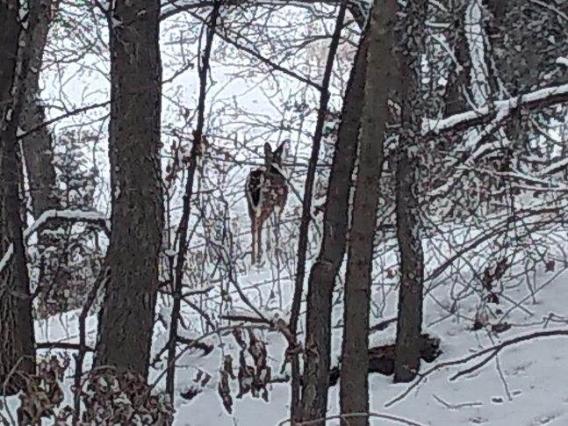
25+ Acres Dixon County, NE EXCEPTIONAL VIEWS - EXCELLENT COVER - ESTABLISHED WILDLIFE RECREATIONAL PARADISE! MISSOURI RIVER - MULBERRY BEND BOAT LAUNCH - TURKEY CREEK EQUISTRIAN CENTER Mike Kumm 402-394-1118

