Slide 1
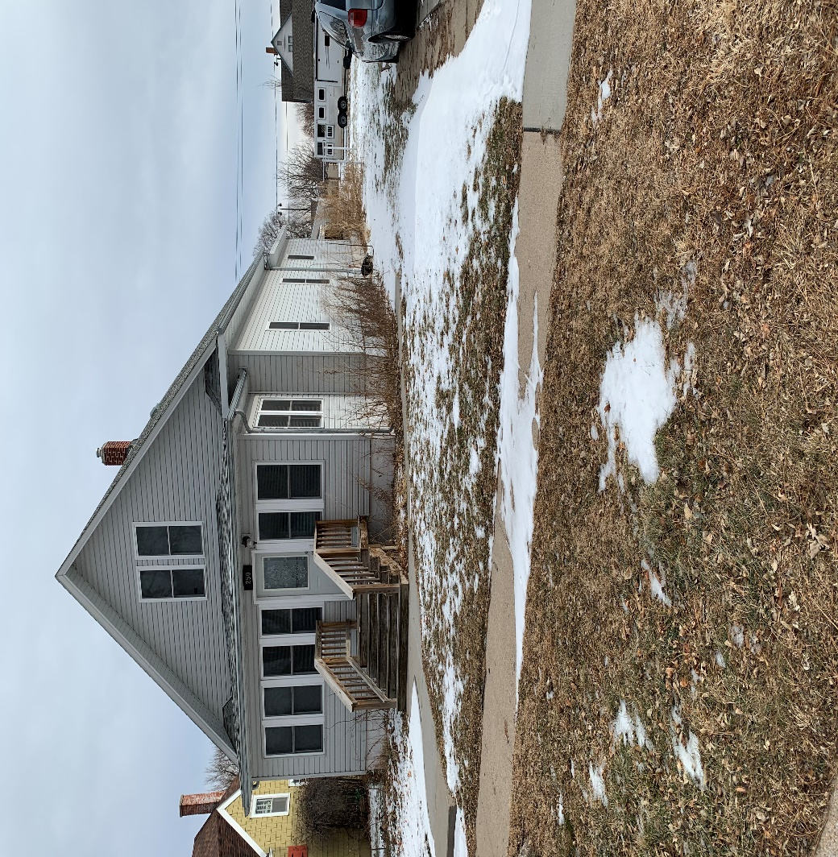
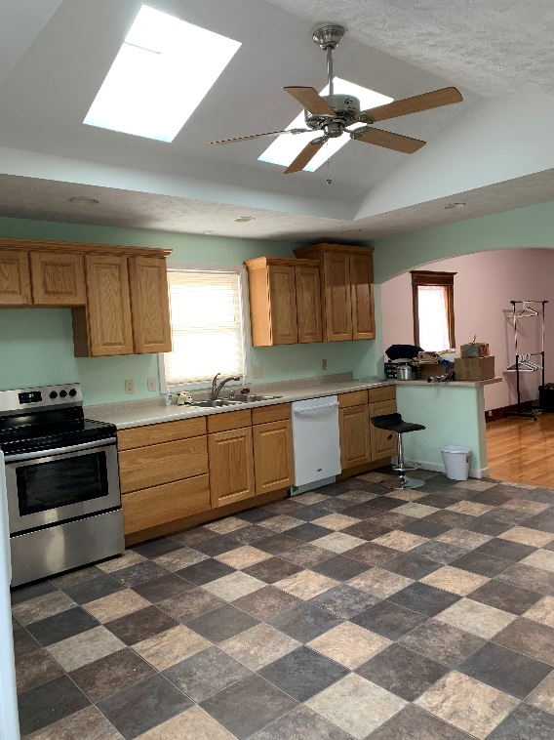
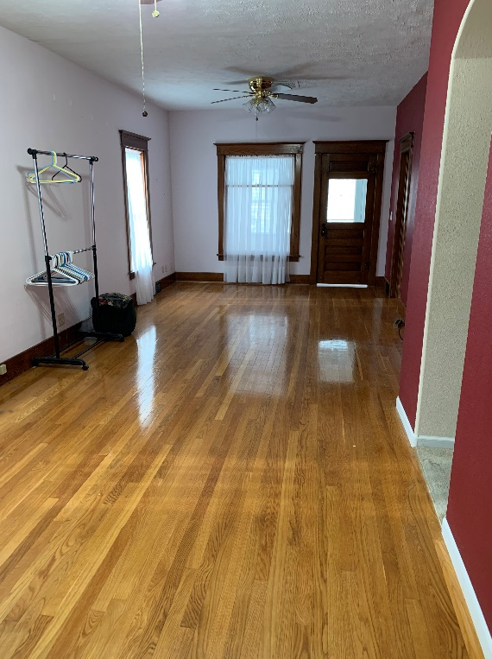
250 S. 5th St., Burwell, ne
Contact
Michele Usasz-Wells 308.750.0522
Modern Home with Vintage woodwork 4 bedrooms, 2 bathrooms, & 2 car detached garage
Many updates
New Roof Oct. 2019, new windows, paint, &
Recent addition!
Appliances are included!

