Slide 1
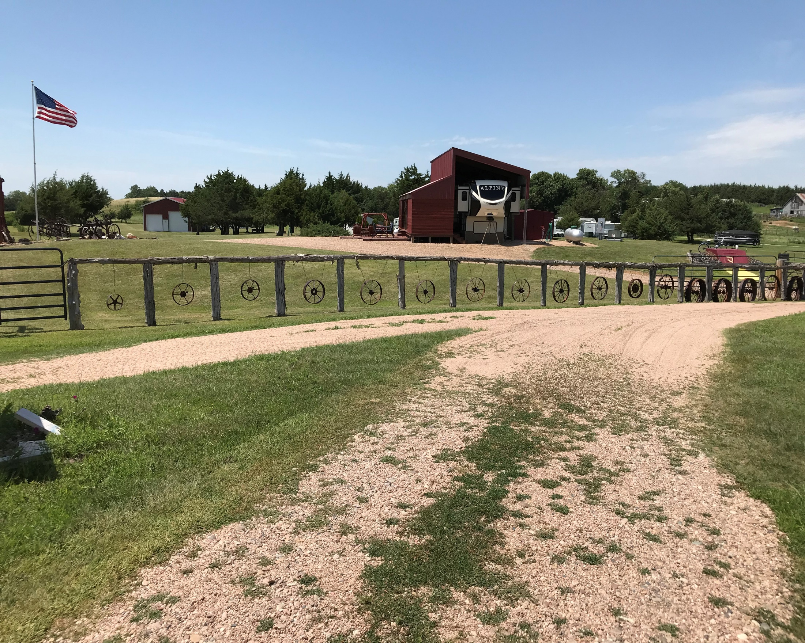
3+ Build-Able Acres (NO RESTRICTIVE COVENANTS) Lake Views - Easy Access - Multiple Camper Usage - Established Storage Lake living is only a plug in away Call for your private showing! Erik Schwager 308-750-0345
Cabin Realty & Ag Services, Inc.
Real Estate Sale & Management
Michele Usasz-Wells, Broker
Office: 308-346-4425
www. CabinRealtyAgServices.com

