Slide 1
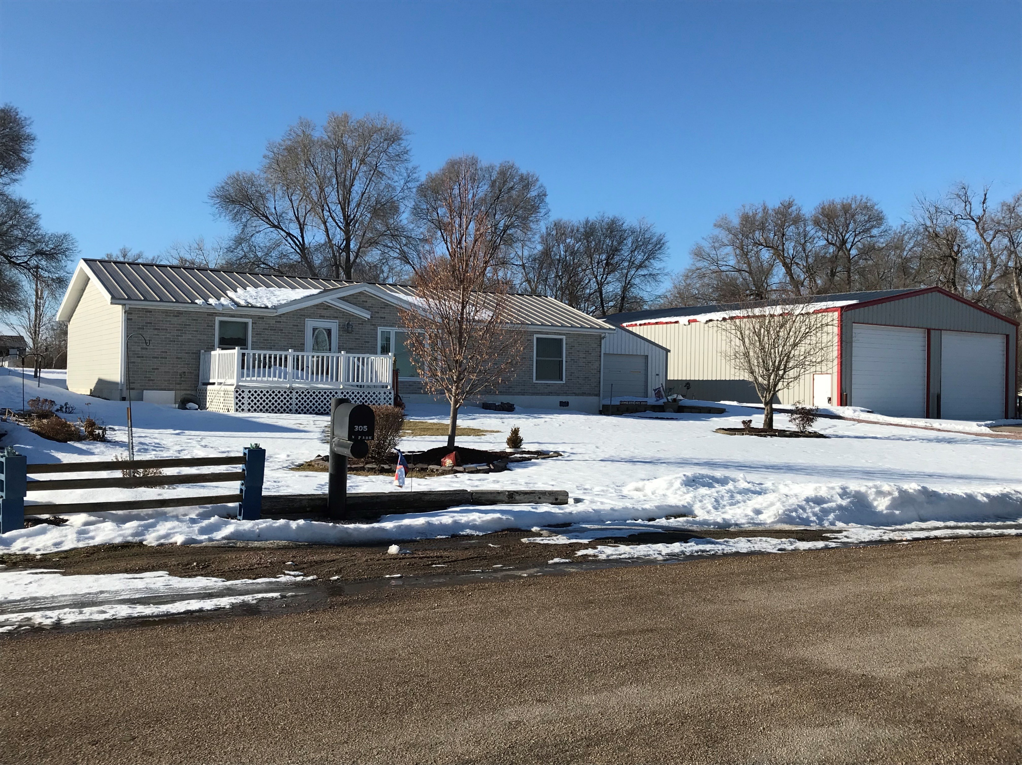
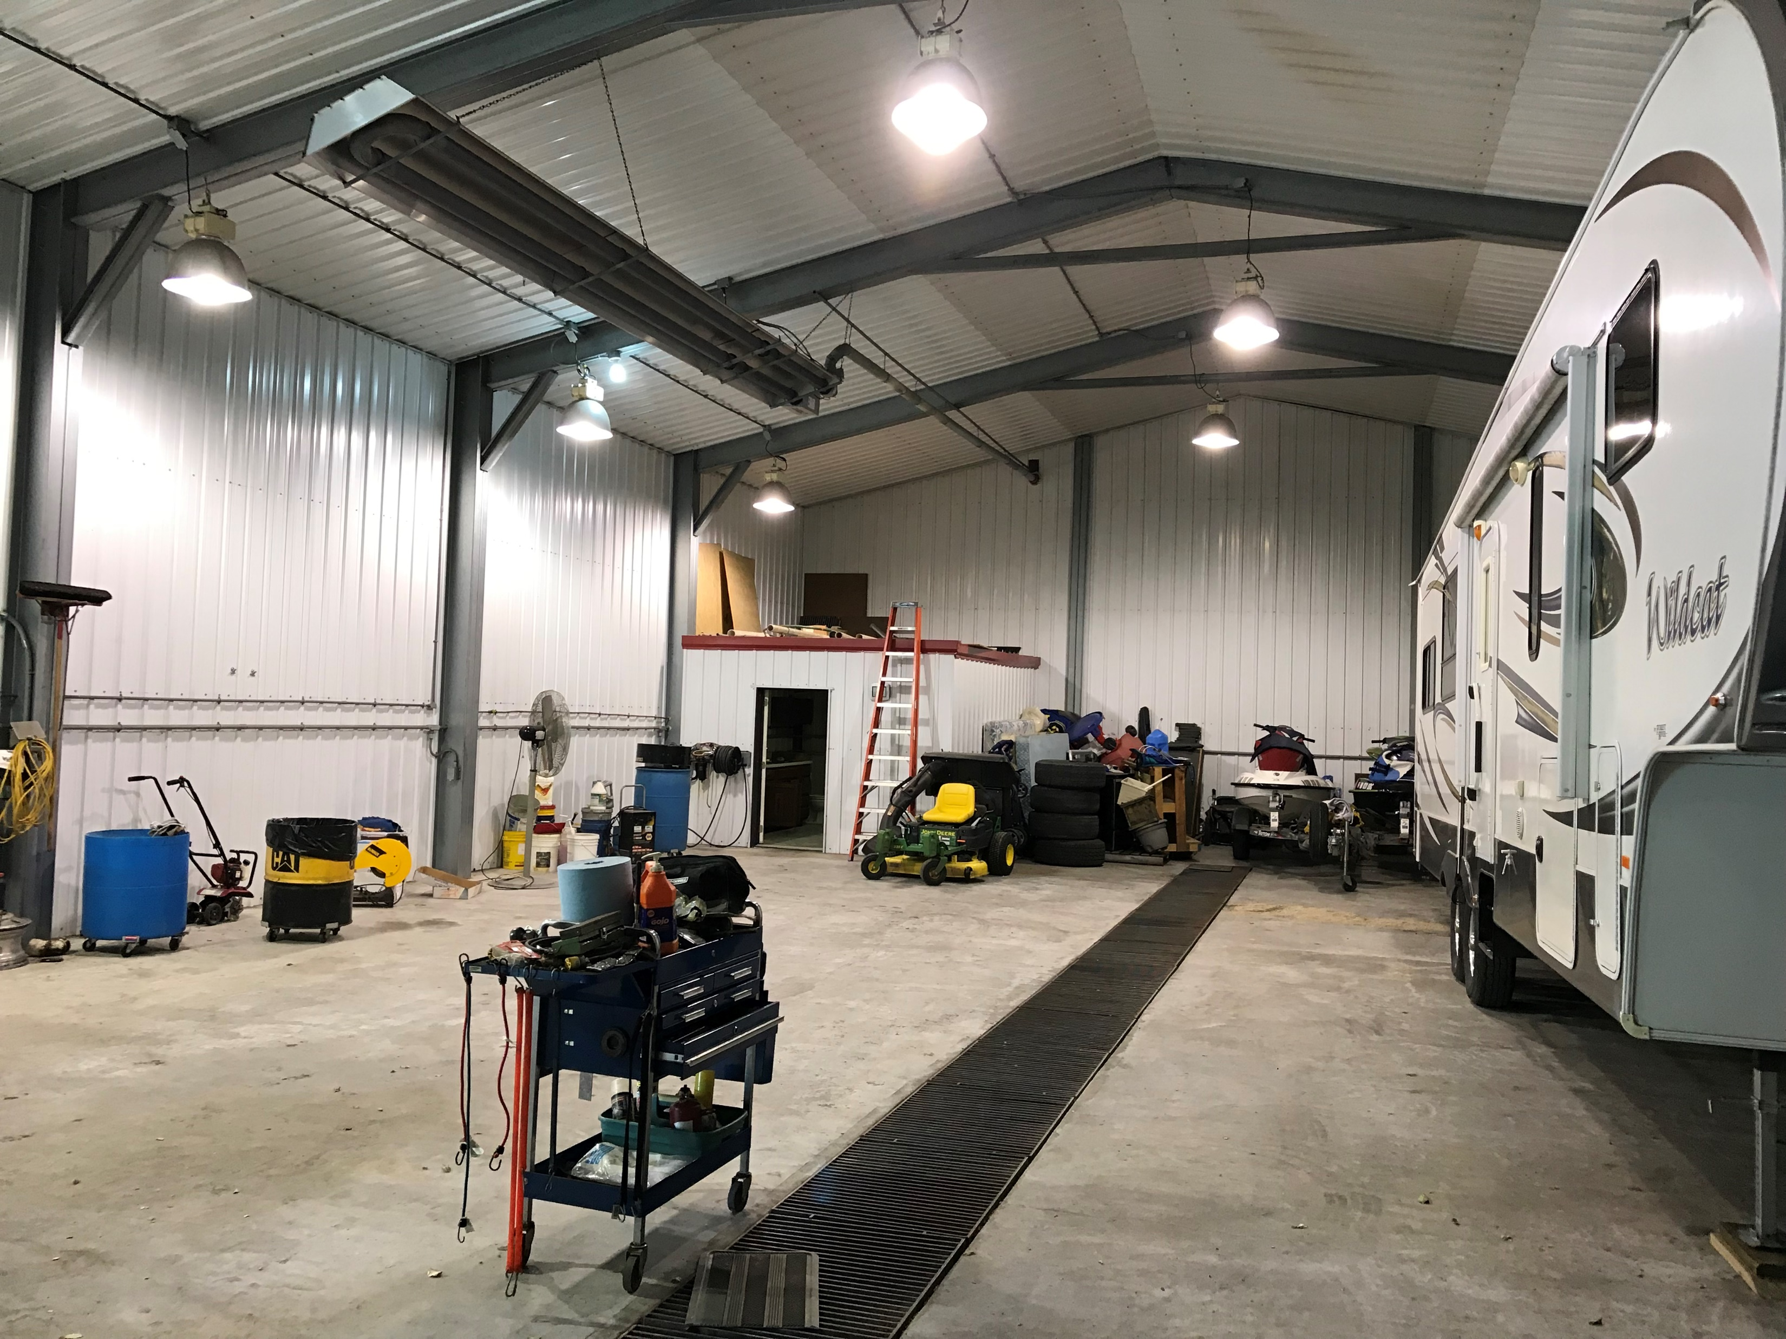
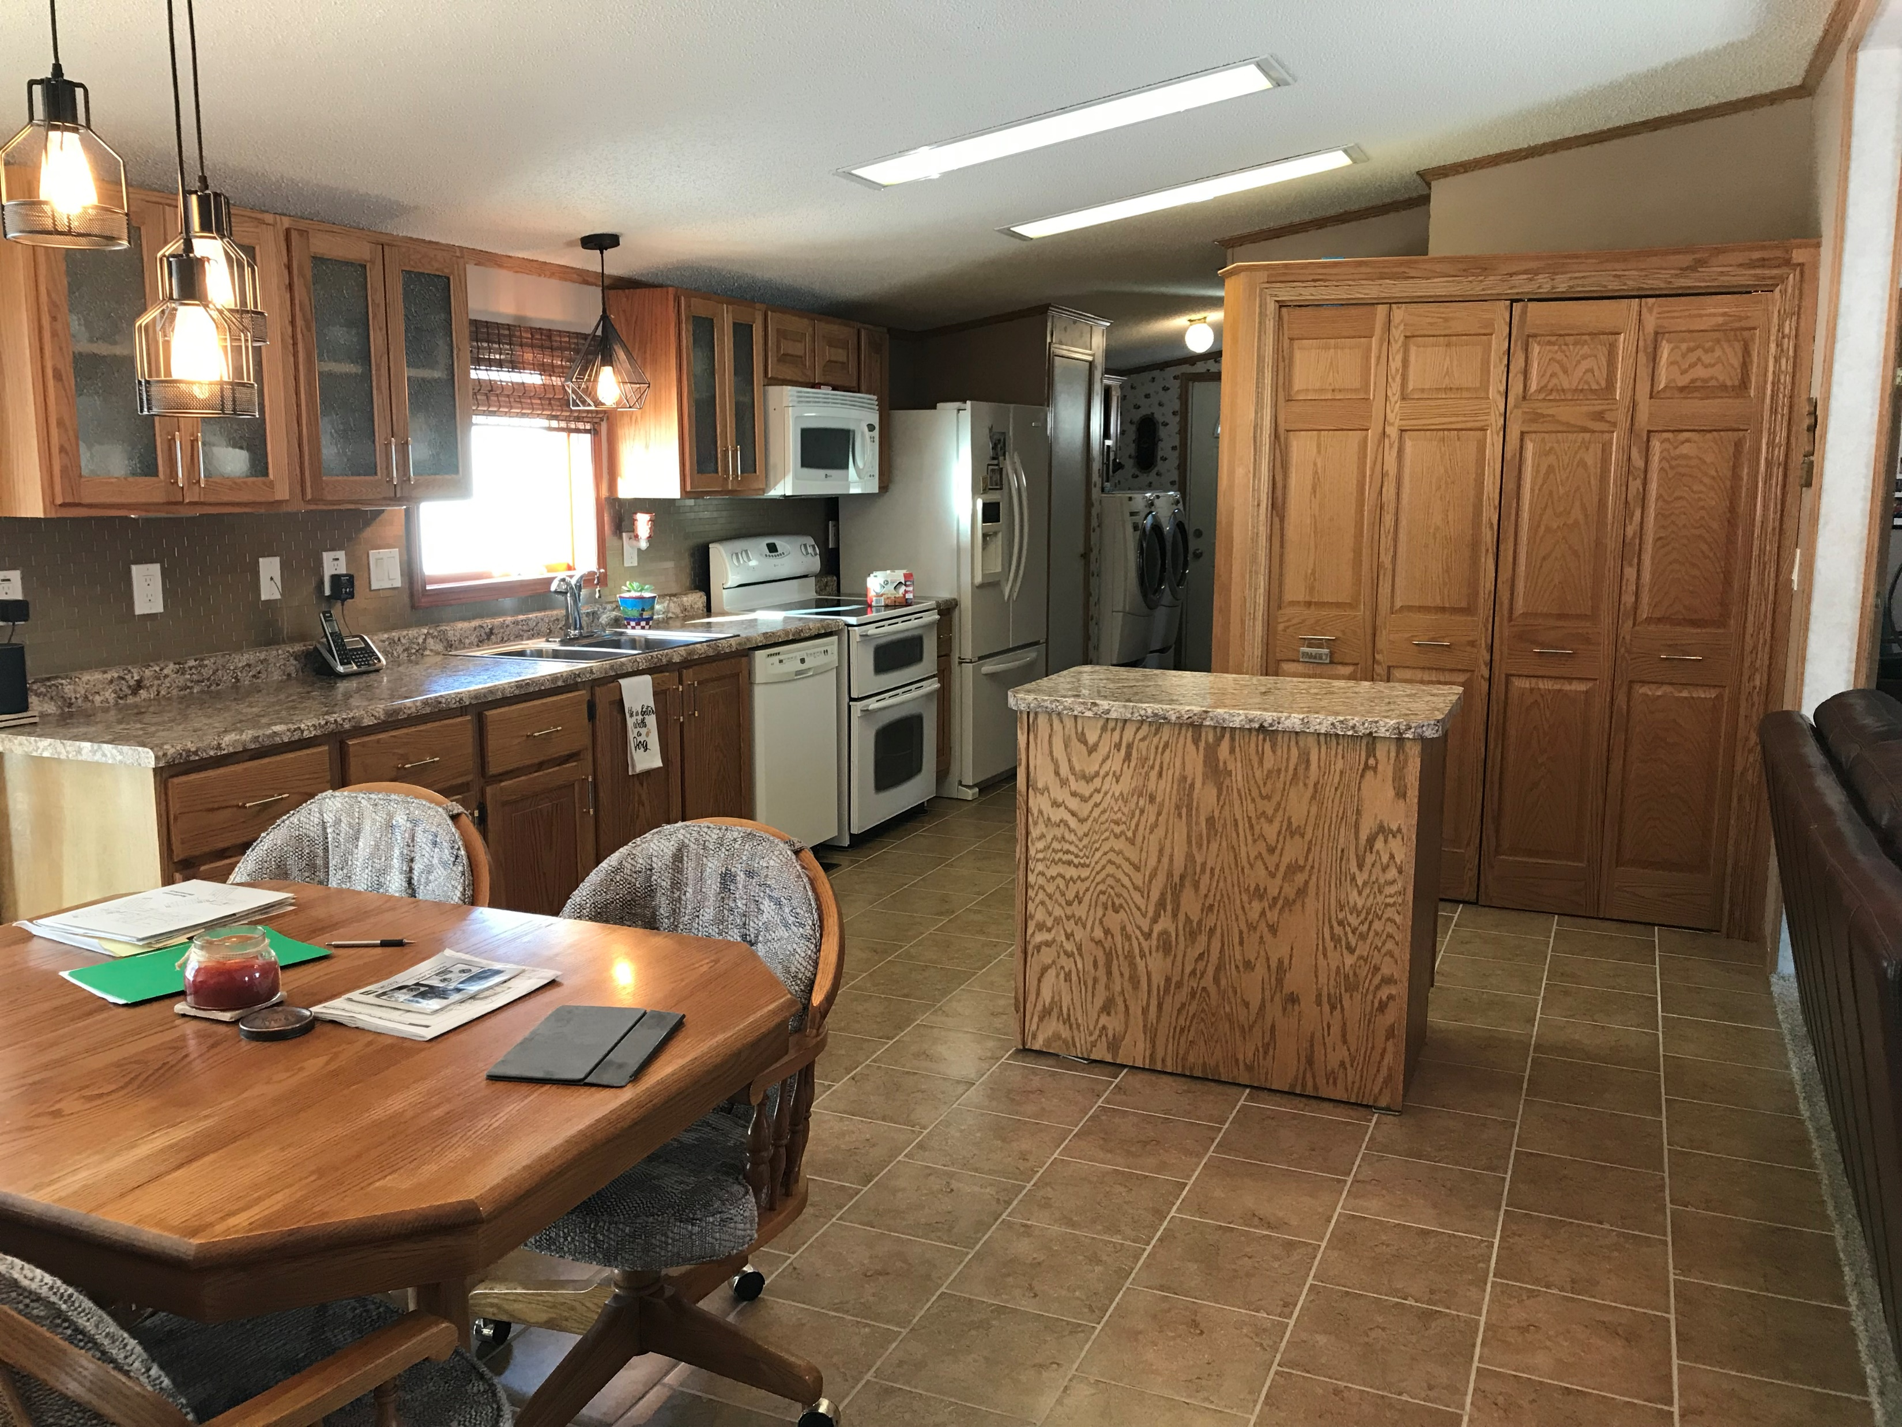
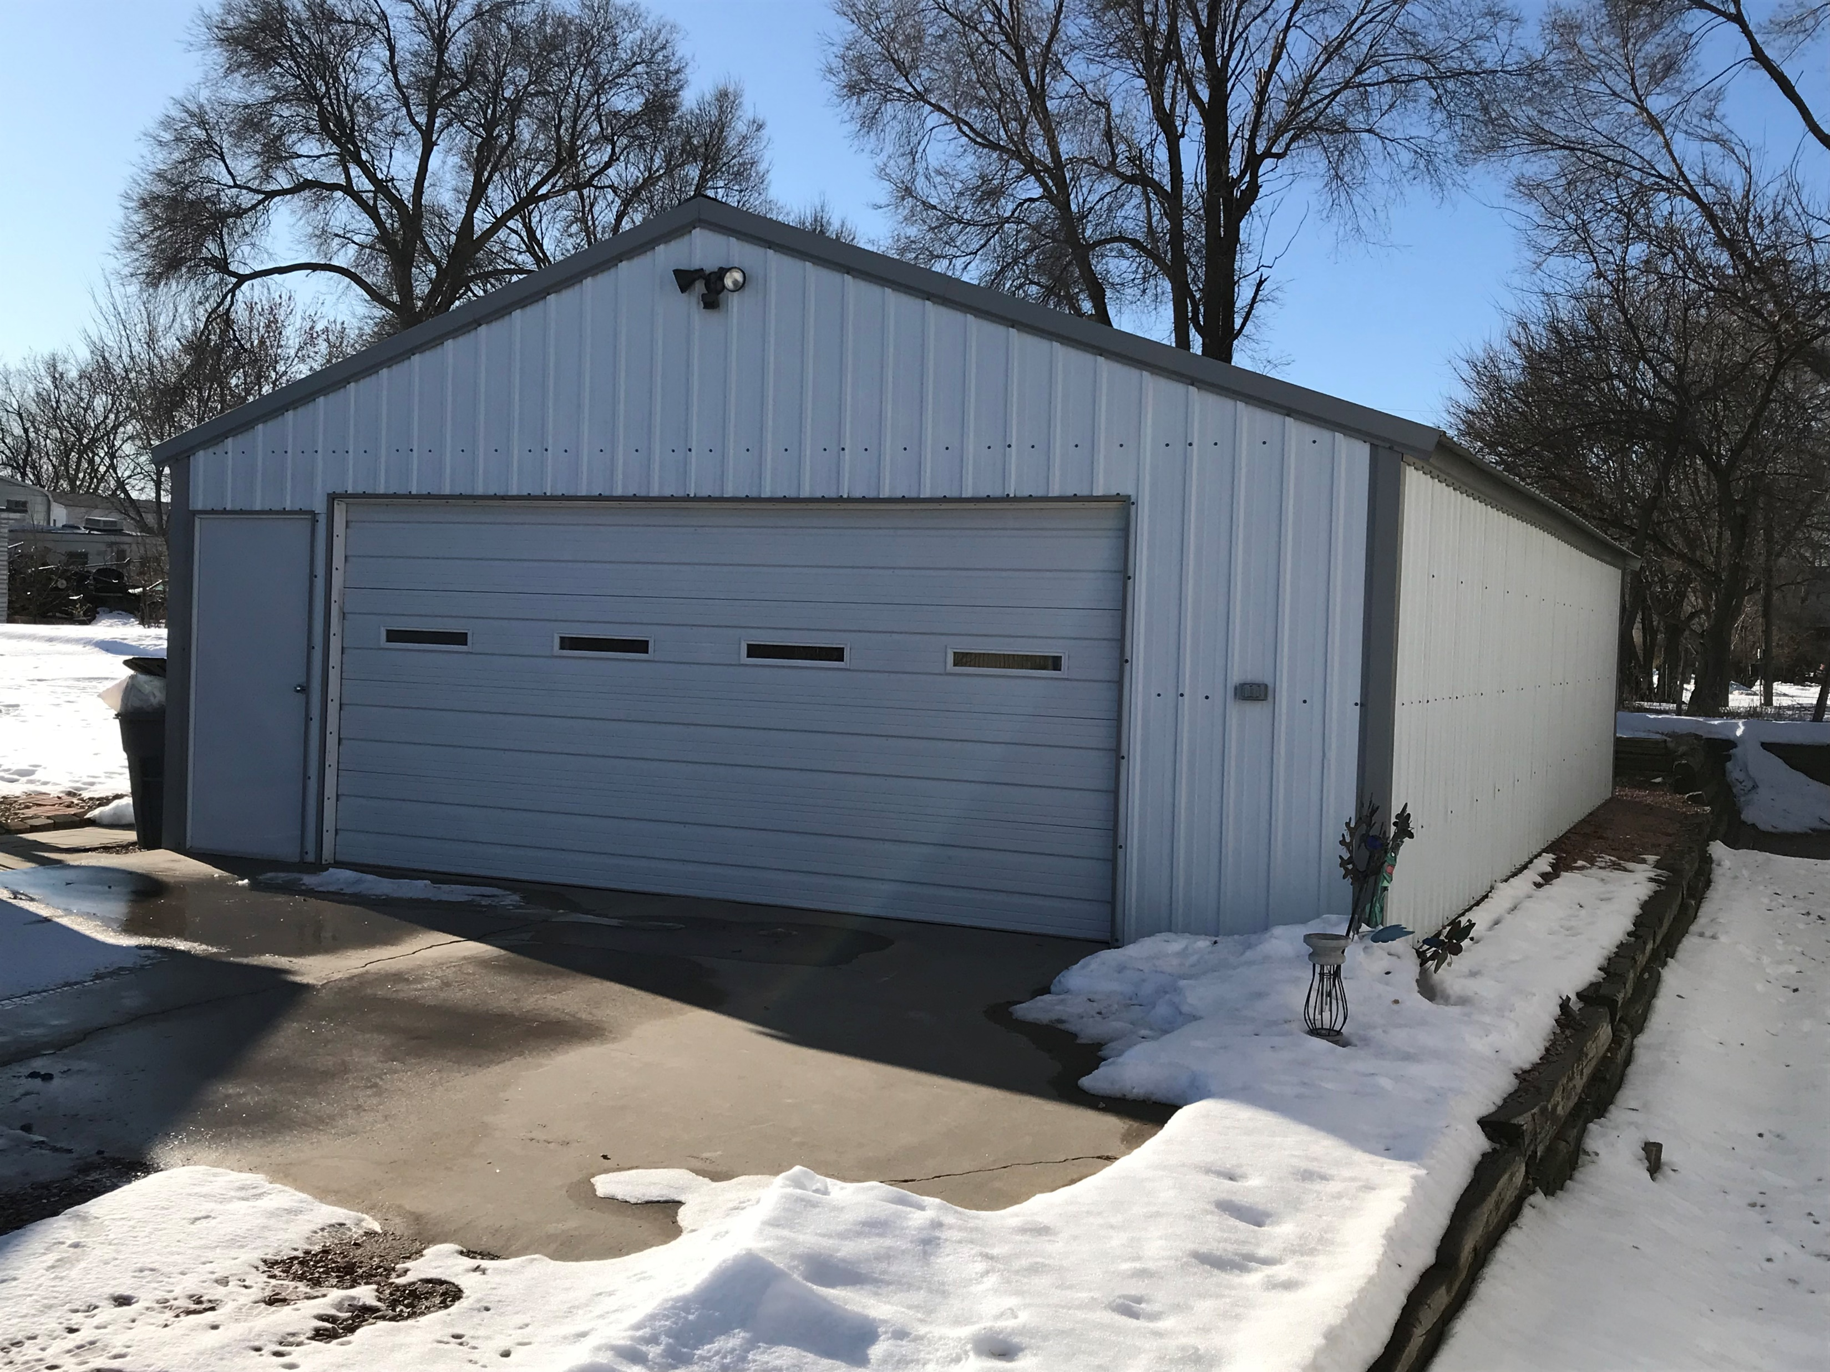
305 N Park St. Bassett, NE
3 Bedroom, 2 Bathroom, & Appliances ( 1,456 sq. ft. )
Detached Steel Garage ( 24’ x 40’
Heated Shop ( 75’ x 44’ )
Office, Heat, Air Compressor, Wash Bay
Rick Foxworthy 402-760-1100

