Slide 1
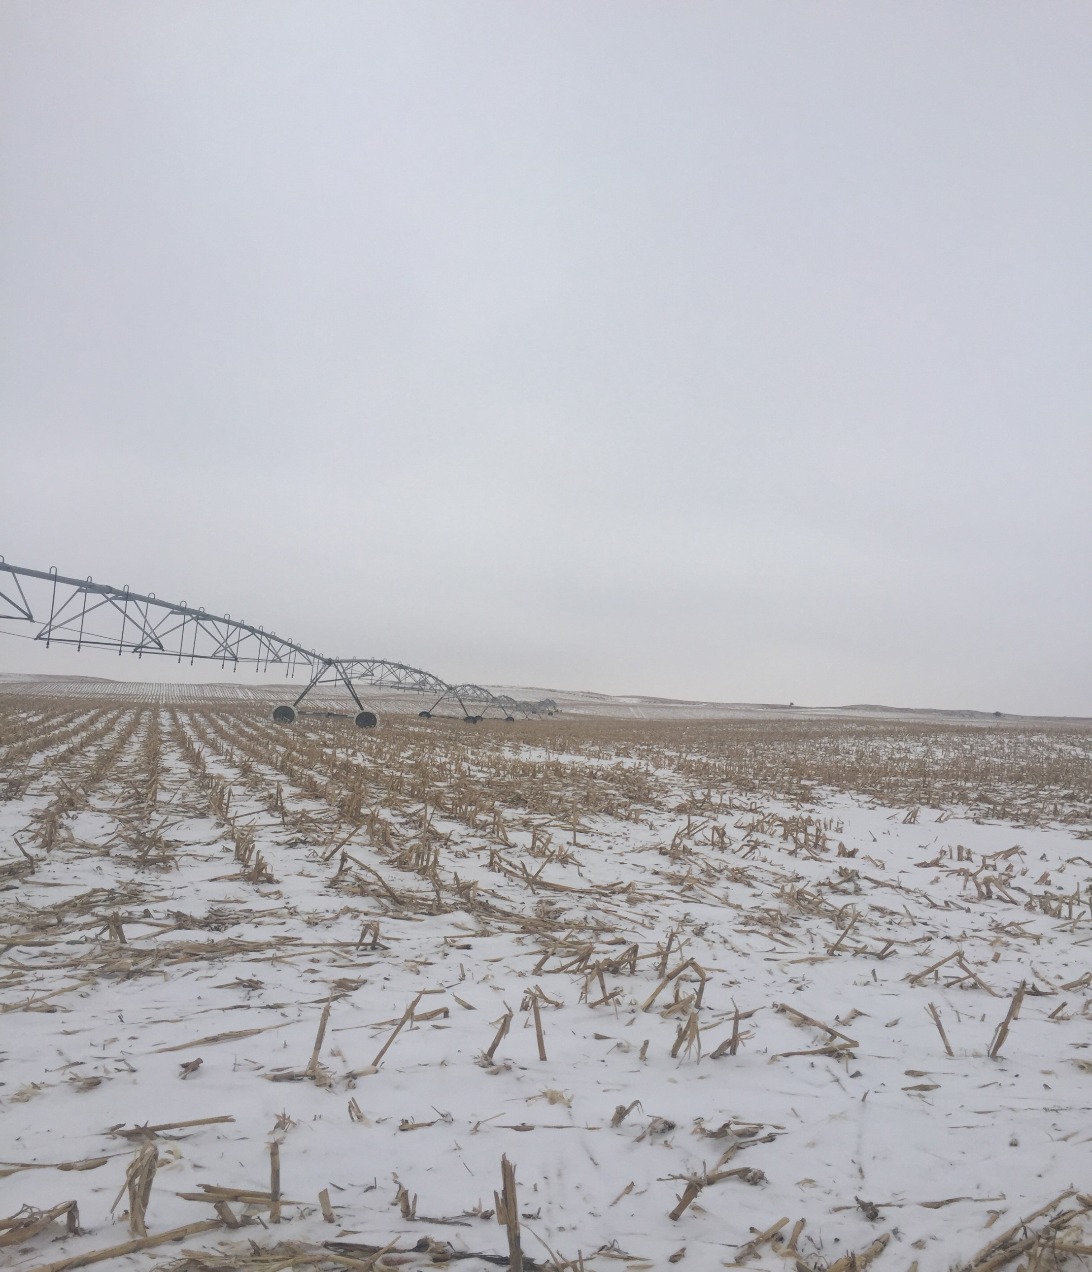
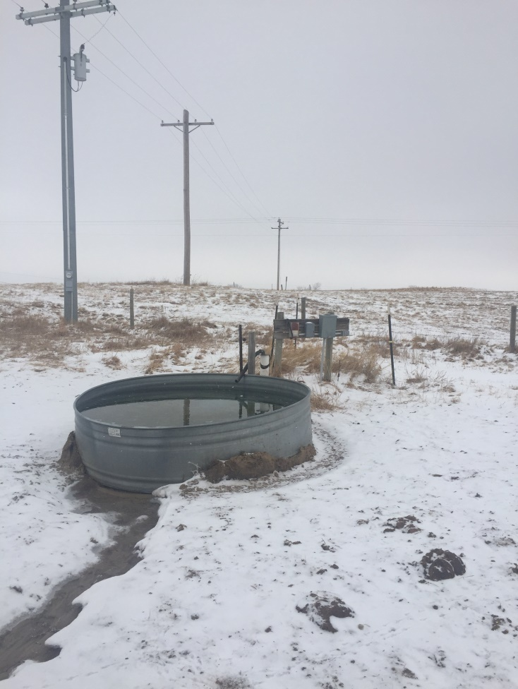
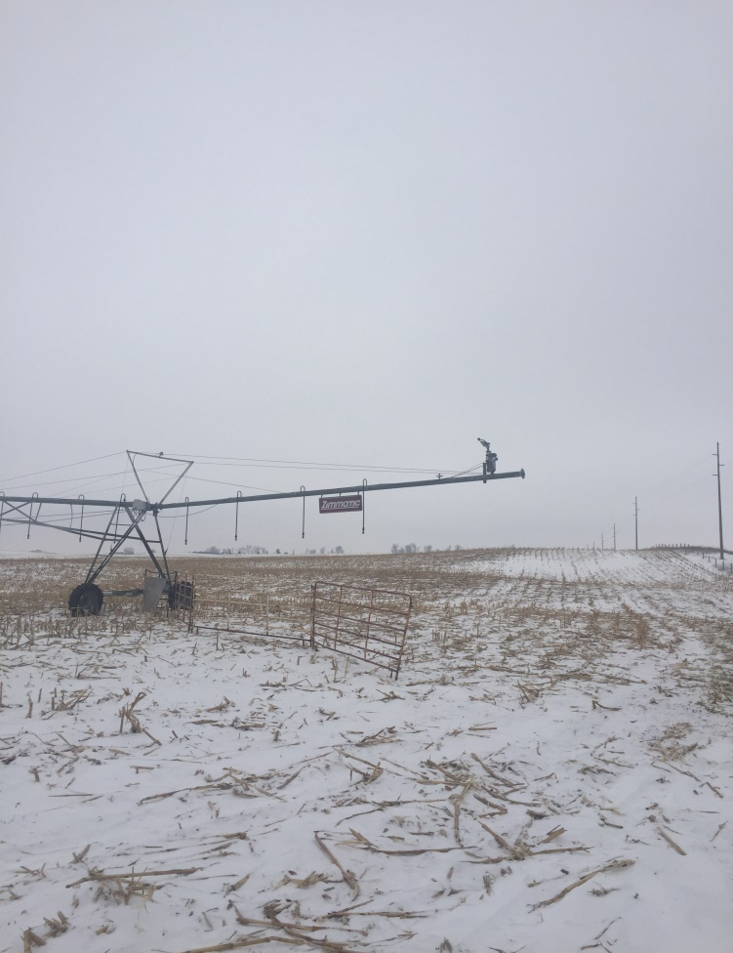
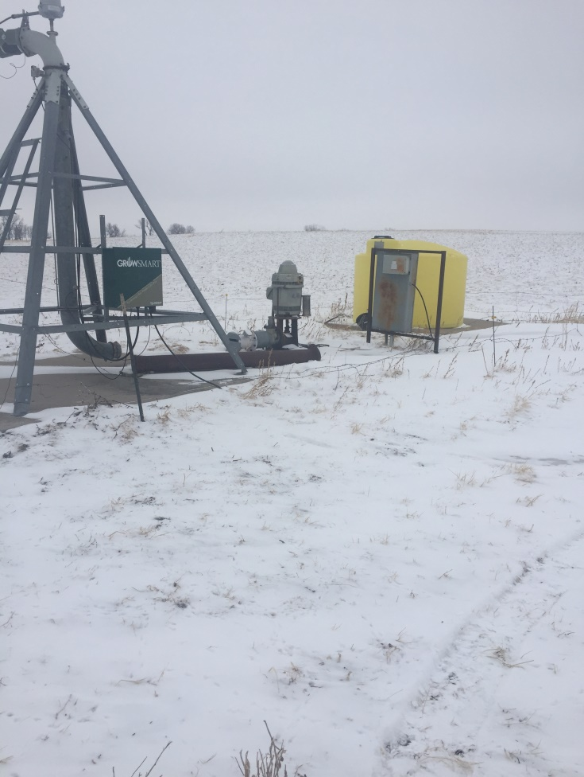
314 +/- Irrigated Acres, Wheeler County, NE
Real Estate Taxes: 2017 - $6,466.52 Contact: Terry K. Held 402.394.1111
These are two very productive quarters, supported by good wells and equipment. This farm has great highway access with a new fence on the east boundary mile. The property is leased for the 2018 crop year.

