Slide 1
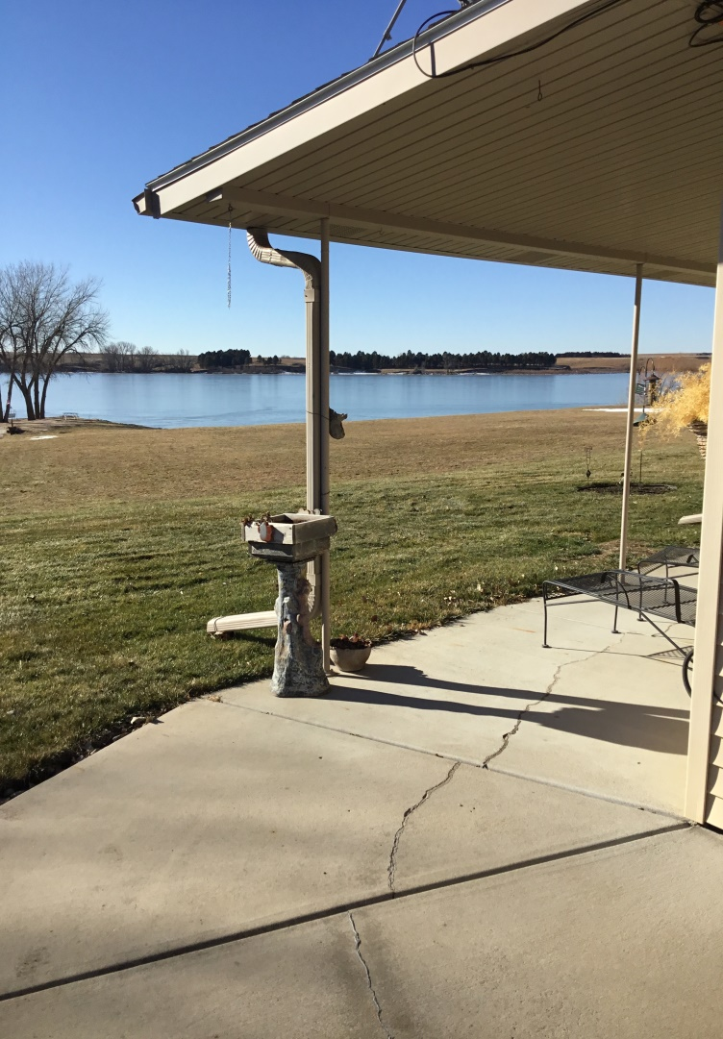
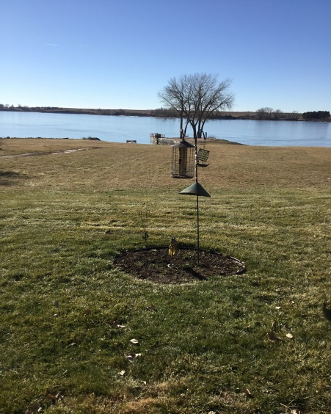
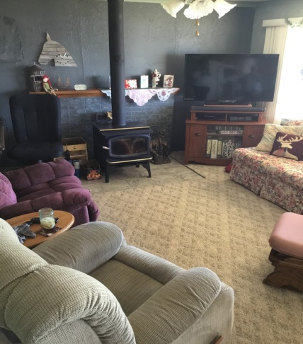
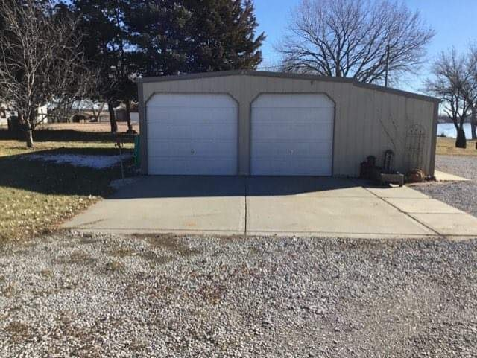
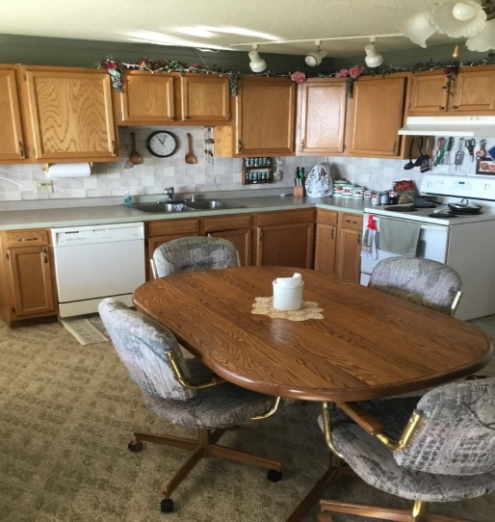
Christy Underwood 402.669.6149 This cozy cabin is at the end of a quiet cul-de-sac with amazing views. The property offers a two bedroom fully furnished home with a detached two car garage. The private cabin lease with Nebraska Game and Parks Commission is available upon request. Spring can not come soon enough to fish, boat and enjoy this property at its finest. Give Christy a call to take in the amazing views!
36 Hilltop Dr. Loup City, NE
Price Reduced!!!
Cabin Realty & Ag Services, Inc.
Real Estate Sale & Management
Michele Usasz-Wells, Broker
Office: 308-346-4425
www. CabinRealtyAgServices.com

