Slide 1
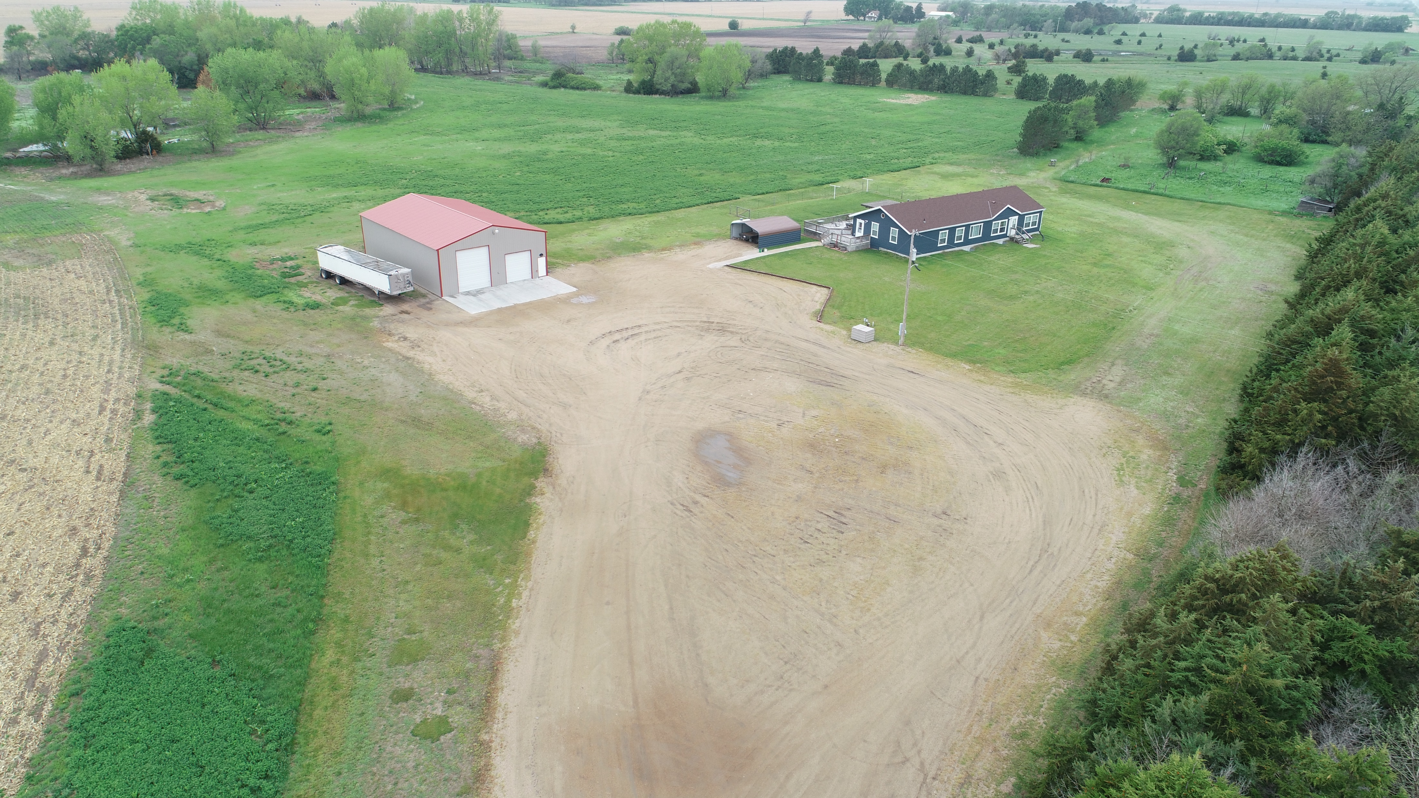
5 Bed, 3 Bath, 40’x 60’ Shop, & Dryland Crop Homestead with Income & Recreational Potential! Erik Schwager 308-750-0345
24+/- Acres Custer County, NE

