Slide 1
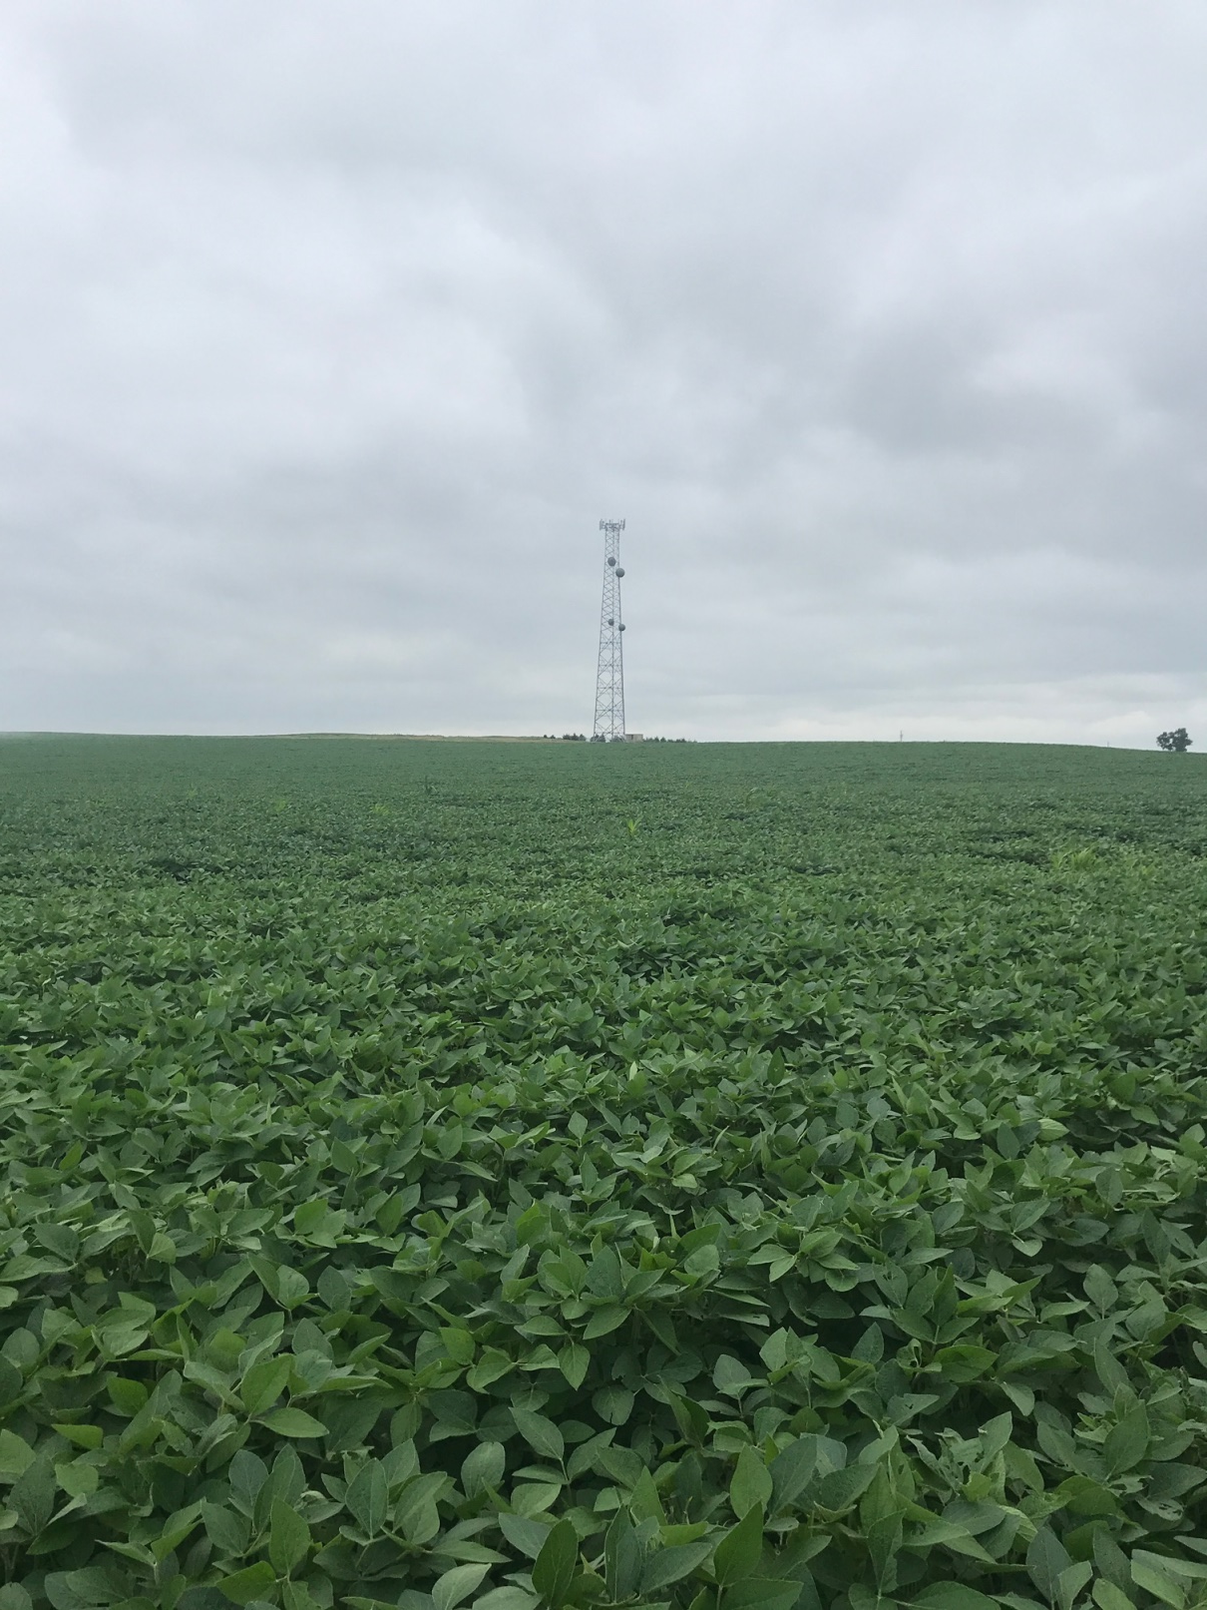
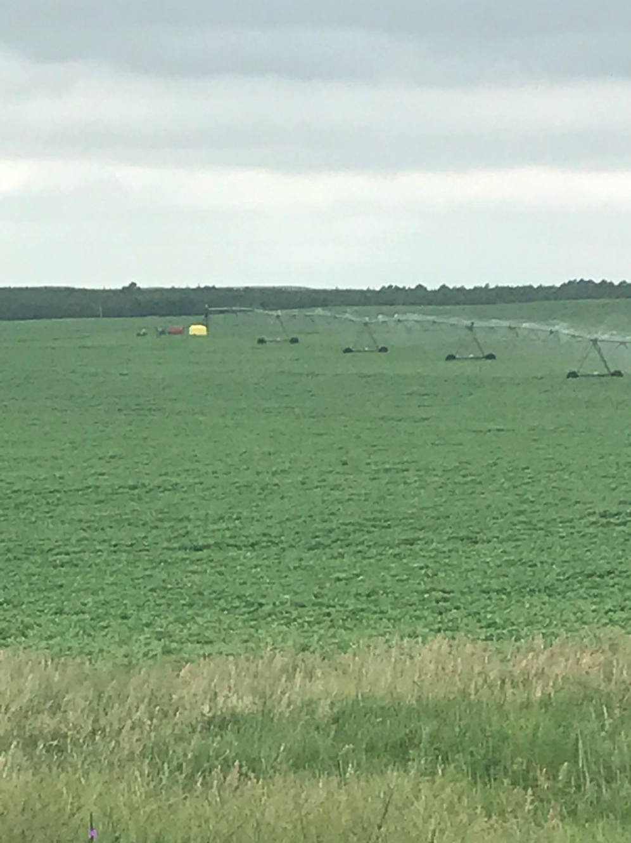
466 +/- Acres, Pivot Irrigated, Rock County, NE
3 Productive Irrigated Quarters
Excellent Road Access.
Rick Foxworthy 402-760-1100
Cabin Realty & Ag Services, Inc.
Real Estate Sale & Management
Michele Usasz-Wells, Broker
Office: 308-346-4425
www. CabinRealtyAgServices.com

