Slide 1
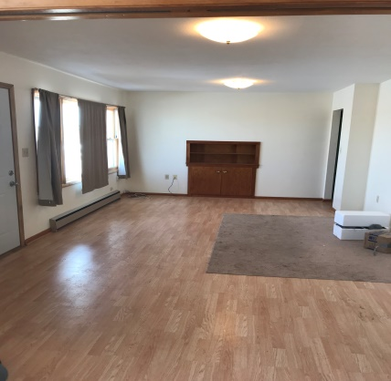
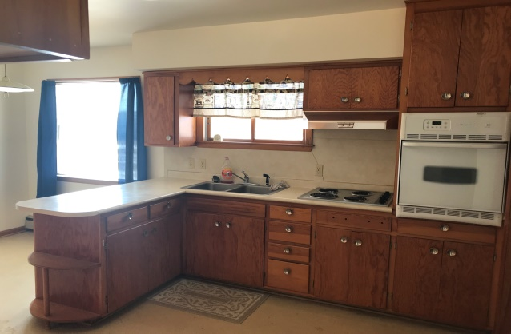
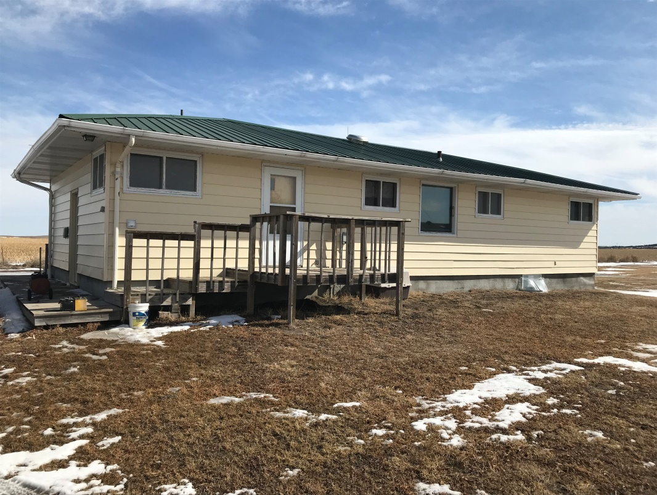
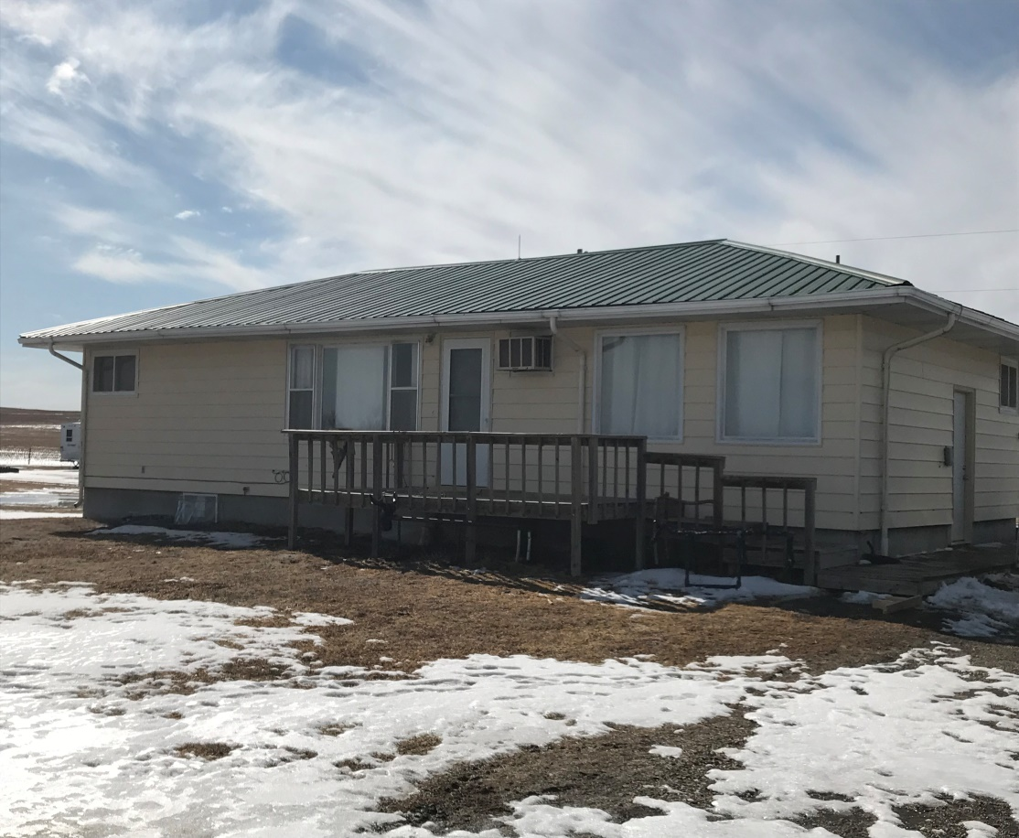
This 2 bedroom 1 & 1/2 bathroom 1,200 sq.ft. house is sitting on recently built concrete basement. The basement is wired and plumbed and with 2 egress windows would be an easy addition to the main level of the house. This all electric home is move in ready with many updates and additions already done with potential to customize to your own needs. Contact: Erik Schwager: 308-750-0345
514 A St. Stapleton, NE
Cabin Realty & Ag Services
Real Estate Sale & Management
Michele Usasz, Broker
Terry K. Held, Associate Broker
Office: 308-346-4425
www. CabinRealtyAgServices.com

