Slide 1
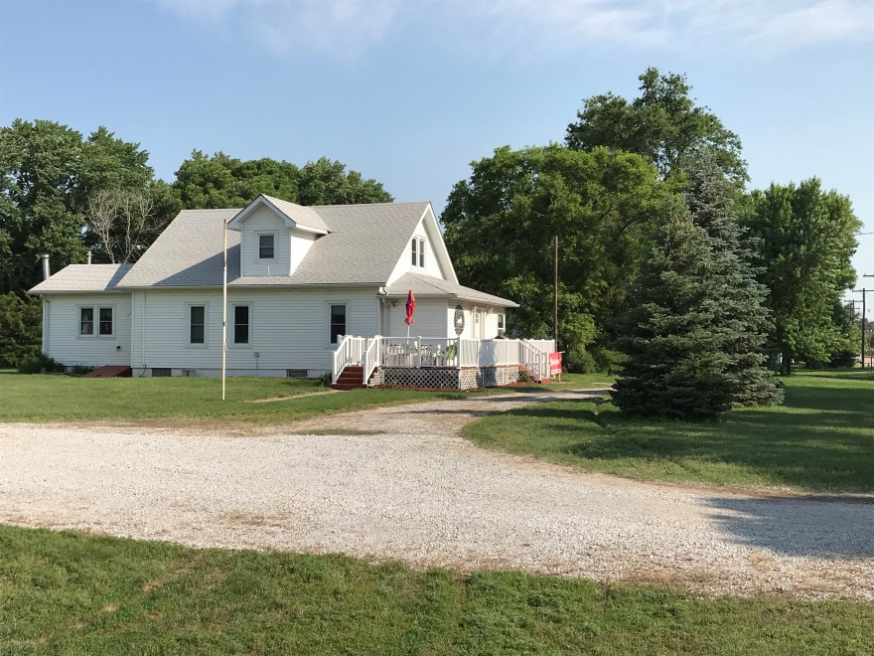
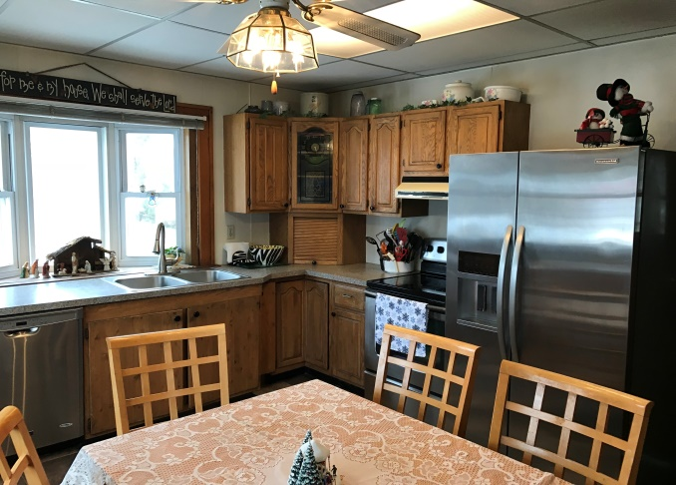
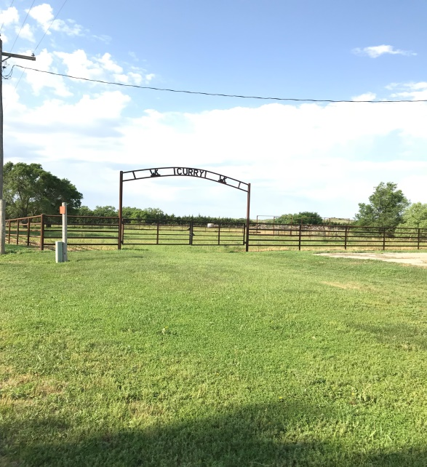
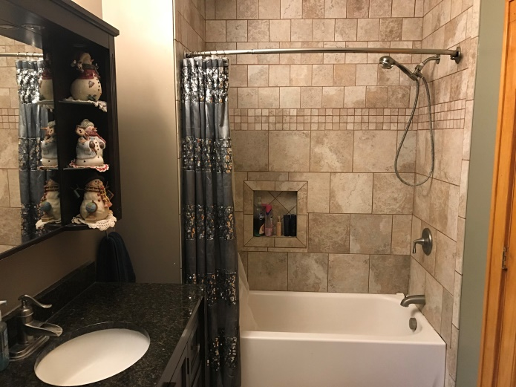
523 Chesapeake St. Ericson, NE
Major Price Reduction!!!
This acreage offers both town and country living. Being located on the southwest corner of Ericson it offers such amenities as city water, city sewer, and trash removal. With the acres attached to the unit livestock capabilities are possible with steel corrals, out buildings, and 2 watering hydrants located in the pens. This multi story residence has lots of room available to match your lifestyle needs. This is an all electric household.
Erik Schwager 308.750.0345

