Slide 1
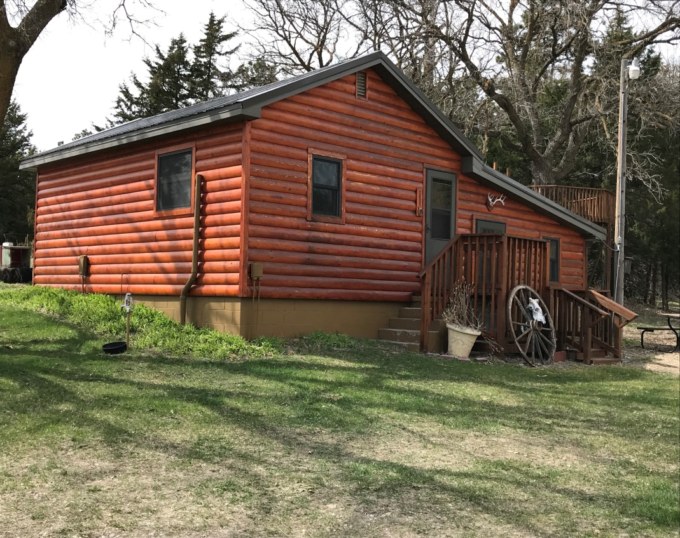
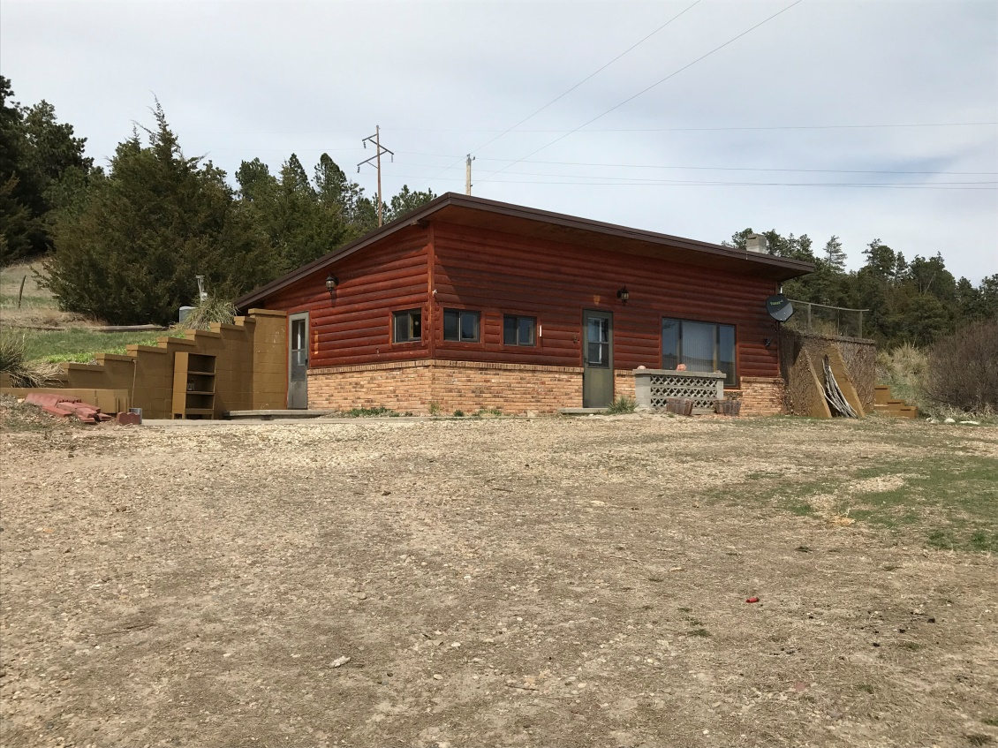
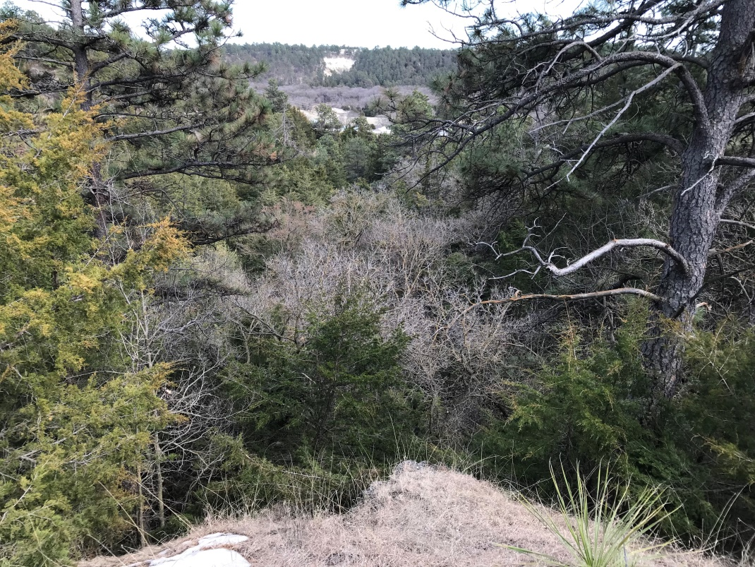
This acreage is a one of a kind scenic get-a-way with great access and huge potential. Location, Location, Location and this homestead offers highway access, walking distance to all the amenities that Keller Park State Recreation Area and Bone Creek offer, secluded canyon views, and additional acres for your outdoor lifestyle. If you need room for livestock the property offers multiple grazing units, and handling facilities equipped with stalls, tack storage, and pens. A log cabin bunkhouse provides additional living space with a built in sauna. This North Central Nebraska acreage has opportunities that are endless to any outdoor enthusiast. Don't miss out this summer! Call for your private tour today! Erik Schwager 308-750-0345
60.9 +/- Acres 43537 Teal Rd Long Pine, NE
Cabin Realty & Ag Services, Inc.
Real Estate Sale & Management
Michele Usasz-Wells, Broker
Office: 308-346-4425
www. CabinRealtyAgServices.com

