Slide 1
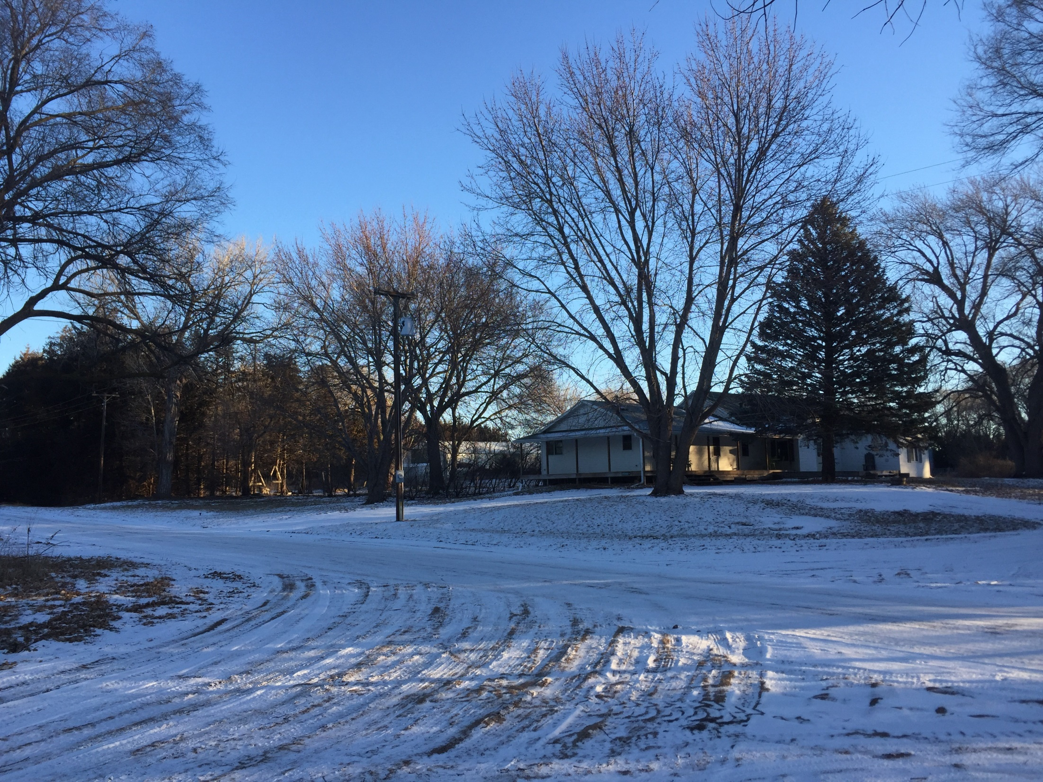
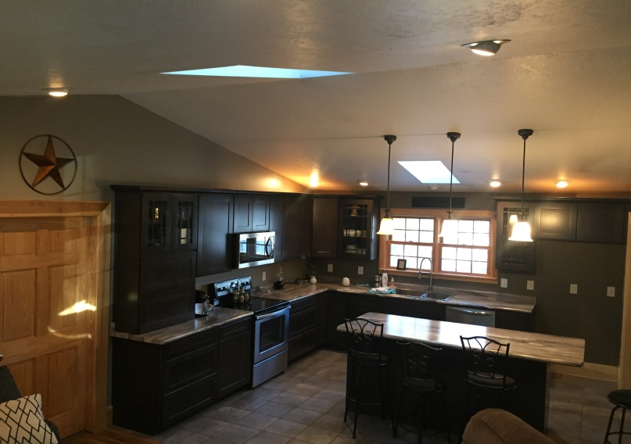
Legal Description: Block 4, Lots 4-12 in Larson’s First Addition List Price: $192,000.00 Real Estate Taxes: 2017 - $1,150.70 Contact: Klay Kasselder 308-201-0168 Comments: This property offers large amounts of sq. footage for both the residence and outdoor usage. The unit is 63,000 sq.ft. or 1.44 +/- acres located near the heart of Ericson, NE. There are multiple out buildings that can handle both storage and working capabilities of livestock. This detached 3 car garage also offers rooms built for mouse proof storage space. The house offers 4 bedrooms and 2 baths with lots of room available to customize or adapt for individual needs. The kitchen is a MUST SEE if you like to entertain or have large family needs offering lots of UPDATES, STORAGE SPACE, & WORKING AREA!!!
613 Huron Ave., Ericson, NE
Cabin Realty & Ag Services
Real Estate Sale & Management
Michele Usasz, Broker
Terry K. Held, Associate Broker
Office: 308-346-4425
www. CabinRealtyAgServices.com

