Slide 1
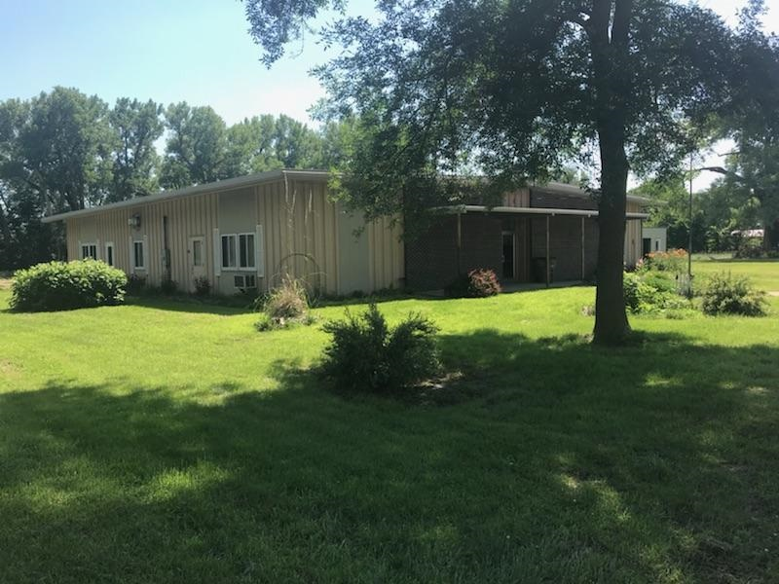
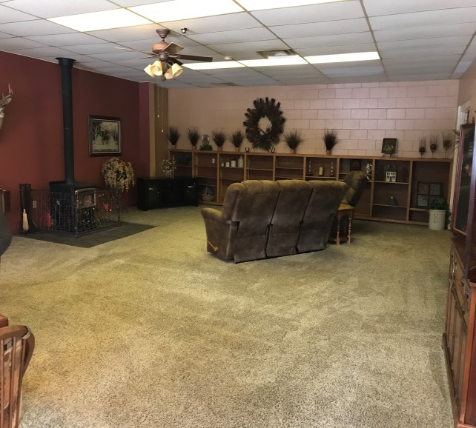
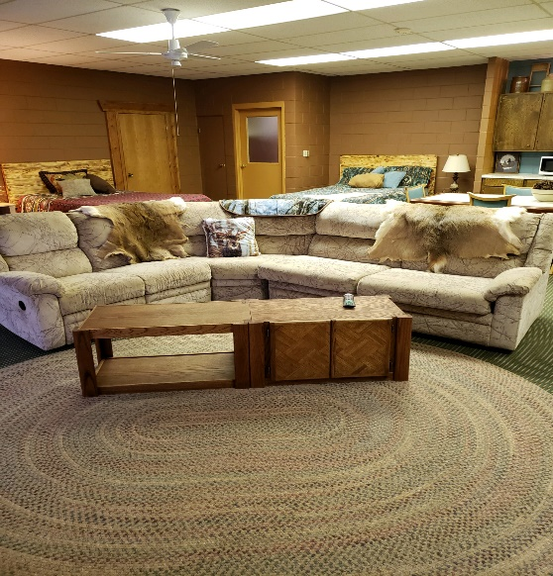
618 Michigan Ave., Ericson, NE
Michele Usasz-Wells 308.750.0522
This single level unit sits on an entire city block. This multi functioning house offers a total of 4,940 sq. ft. with an attached heated garage/workspace that is 1,036 sq. ft. leaving 3,904 sq. ft. for living space. The living area offers 3 bedrooms, 2 bathrooms, electric heat pump, and large open multipurpose room with wood heat. The diversity of this floor plan makes it unique and adaptable to a variety of needs. Outdoor storage is provided by a 12' by 30' steel building equipped with electricity. One bedroom is setup and being used for rental purposes if your looking to gain some income from your residence.
Real Estate Taxes: 2018 - $859.62
New Listing!

