Slide 1
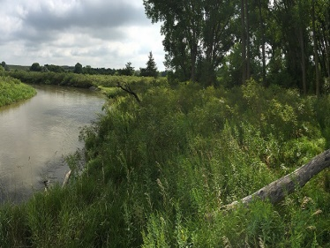
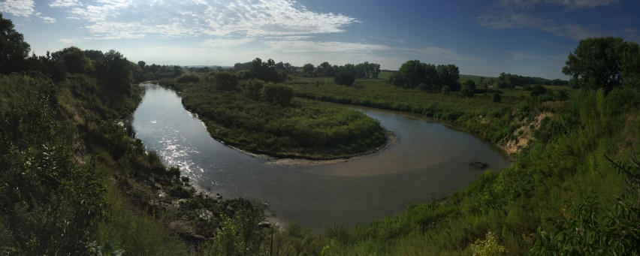
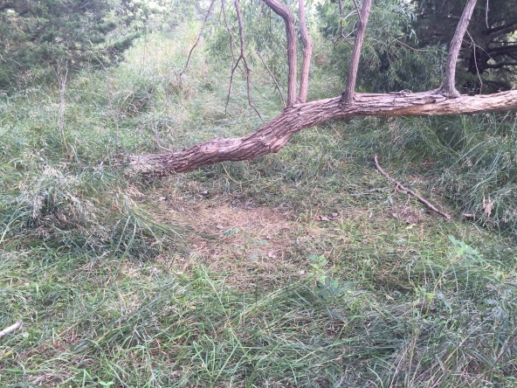
Legal Description: Tract of land in the S1/2 of NE1/4 Section 2, Township 20N, Range 11W of the 6th P.M., Greeley County, NE Real Estate Taxes: 2017- approx $1,228.96 Contact: Klay Kasselder - 308-201-0168 Comments: 1.5 miles of Cedar River runs through this hunter's paradise! Property is divided by Hwy 281, and can be sold as two separate tracts of 32 & 36 +/- acres.
2 Tracts River Frontage, Greeley County, NE
Cabin Realty & Ag Services
Real Estate Sale & Management
Michele Usasz, Broker
Terry K. Held, Associate Broker
Office: 308-346-4425
www. CabinRealtyAgServices.com

