Slide 1
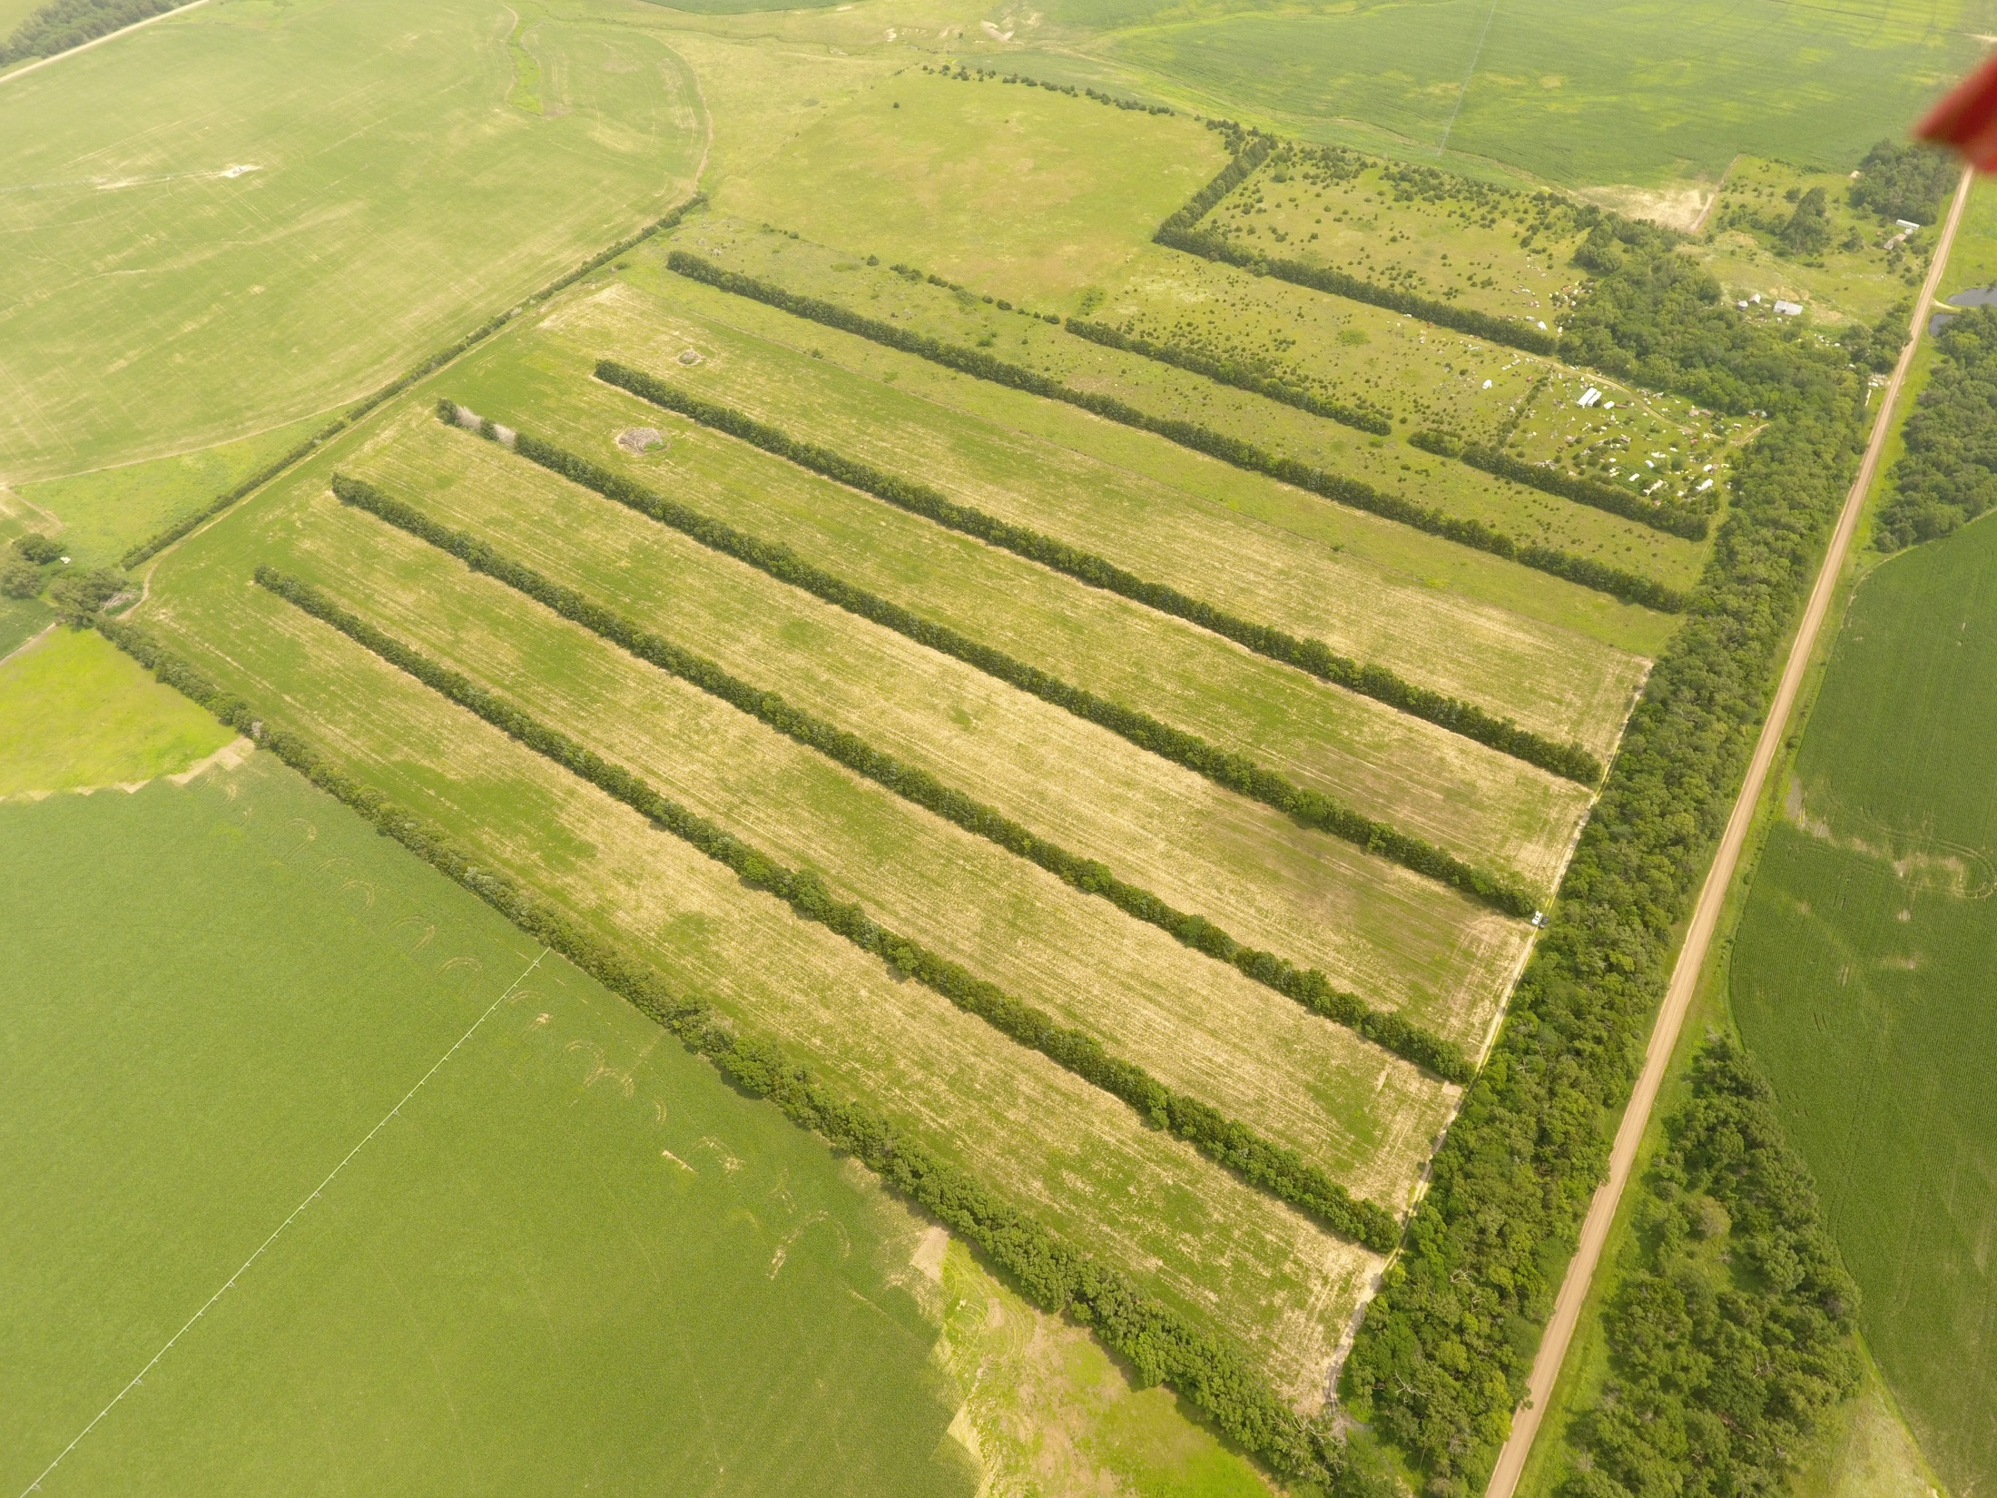
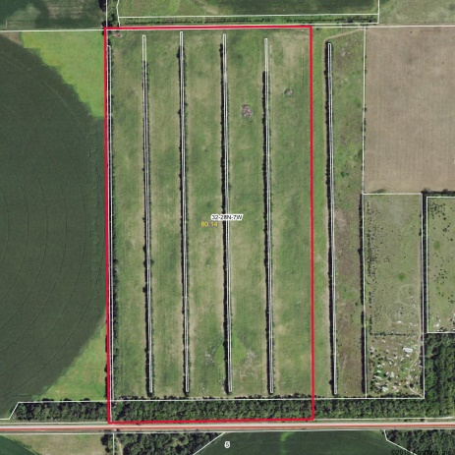
MINUTES AWAY FROM GROVE LAKE STATE REC. AREA 80 +/- Acres Antelope County, NE Location: 1 mile N & 1 ½ miles W of Royal, NE Real Estate Taxes: 2017 - $1,335.76 Contact: Erik Schwager 308.750.0345 This property offers many recreational amenities as well as being productive cropland. Located just over a mile away is the Grove Lake State Wild Life Management Area offering 2,008 acres of prime habitat for deer, turkey, pheasant, quail and fishing. This 80 +/- acre unit has abundant cover and feed holding multi species of wildlife within its borders. Multiple shelters belts run thru the cropland and surround the premises offering a well preserved feeling of seclusion. This property is also being offered as 2 separate 40 acre tracts. A RECREATIONAL UNIT with INCOME POTENTIAL!!! Come scout it out today!!!
Cabin Realty & Ag Services
Real Estate Sale & Management
Michele Usasz, Broker
Terry K. Held, Associate Broker
Office: 308-346-4425
www. CabinRealtyAgServices.com

