Slide 1
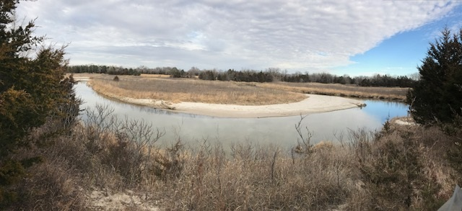
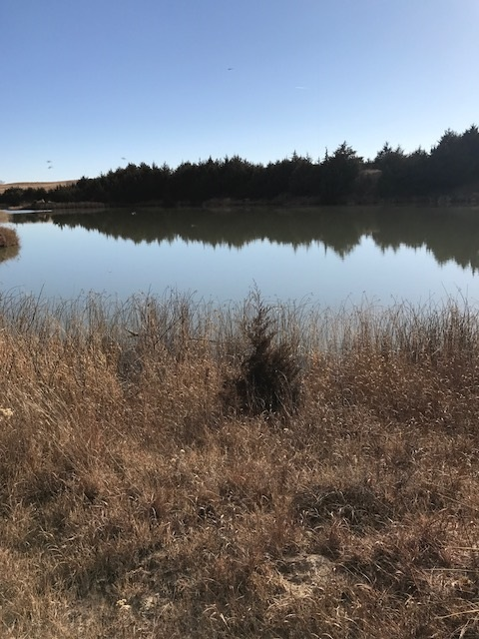
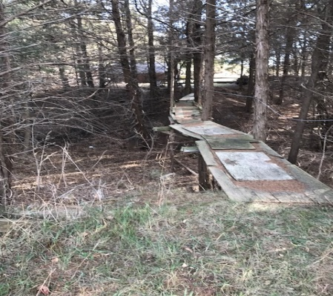
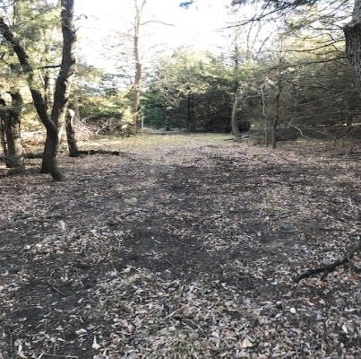
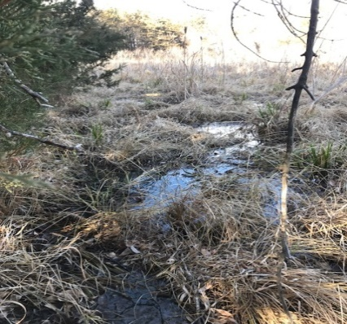
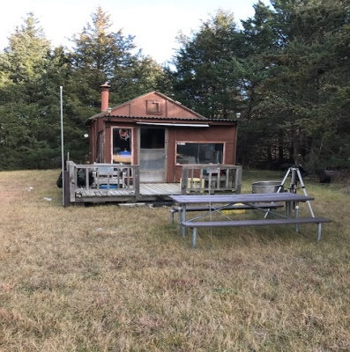
This property is full of nature filled activities. It offers the feeling of seclusion with its deep wilderness atmosphere. There is approximately one mile of Cedar River Frontage, natural springs, pond access, and two small hunting cabins. If you enjoy hunting, fishing, swimming, hiking, exploring, or just connecting with nature you will find it here. River access leads to Lake Ericson only a short mile down river from location. Come see for yourself what this property has to offer, you won't be DISAPPOINTED!!!
81.9 +/- Recreational Acres Ericson, NE Contact: Michele Usasz 308.750.0522
Cabin Realty & Ag Services
Real Estate Sale & Management
Michele Usasz, Broker
Terry K. Held, Associate Broker
Office: 308-346-4425
www.CabinRealtyAgServices.com

