Slide 1
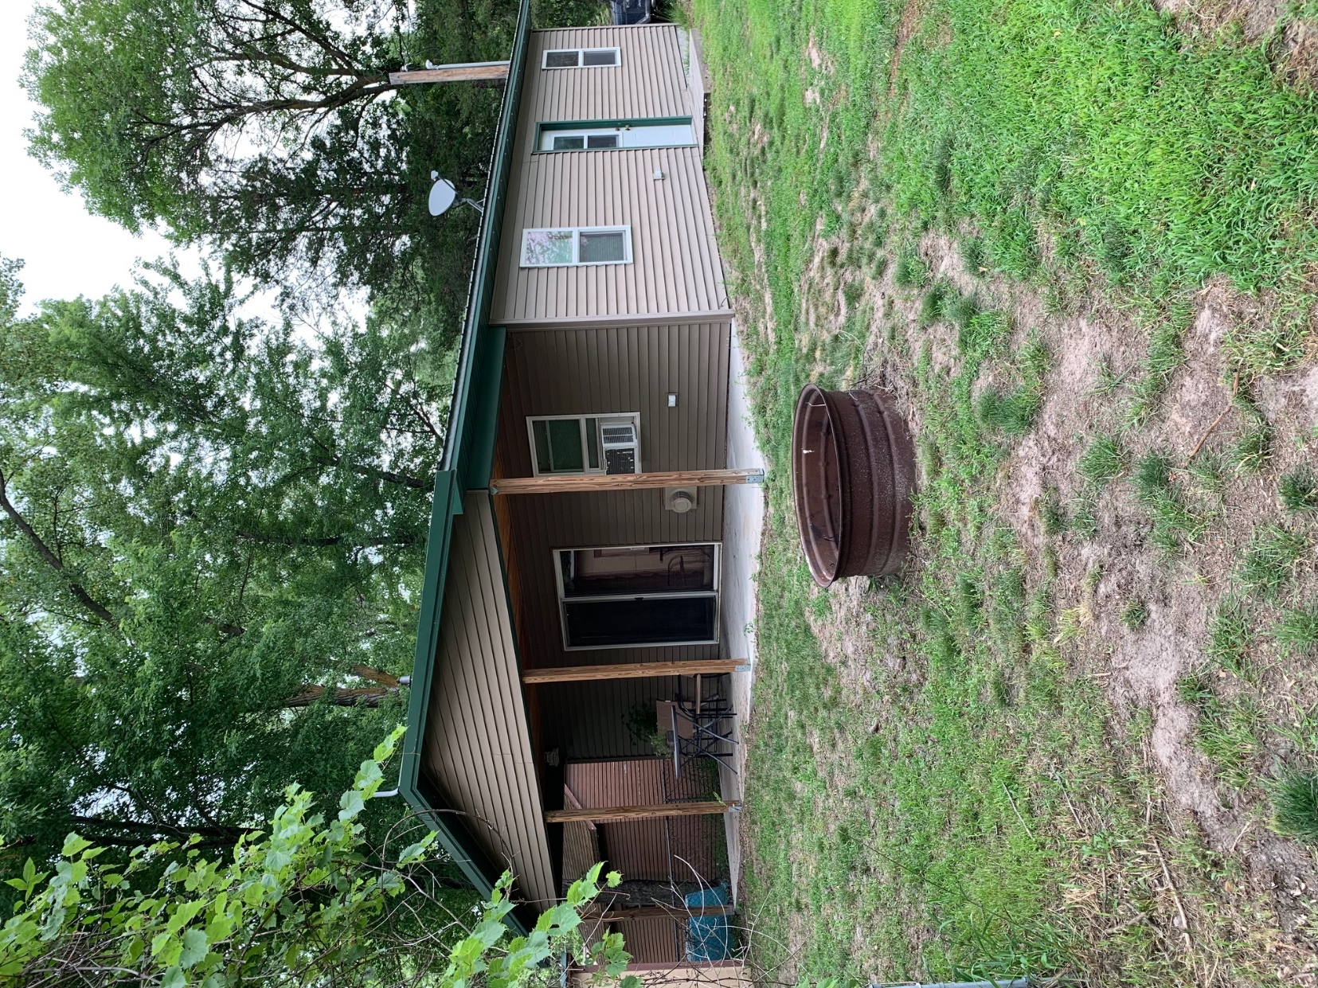
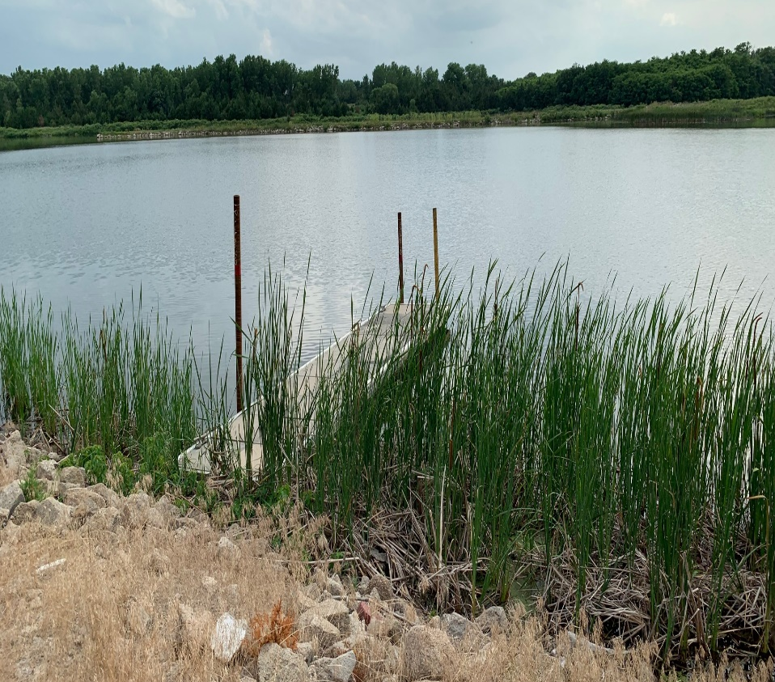
82375 OFFILL ST.
LAKE ERICSON
Built in 2012 - 2 Bedrooms - 1 Bathroom - Covered Deck
PRIVATE DOCK!
Michele Usasz-Wells 308.750.0522
Cabin Realty & Ag Services, Inc.
Real Estate Sale & Management
Michele Usasz-Wells, Broker
Office: 308-346-4425
www. CabinRealtyAgServices.com

