Slide 1
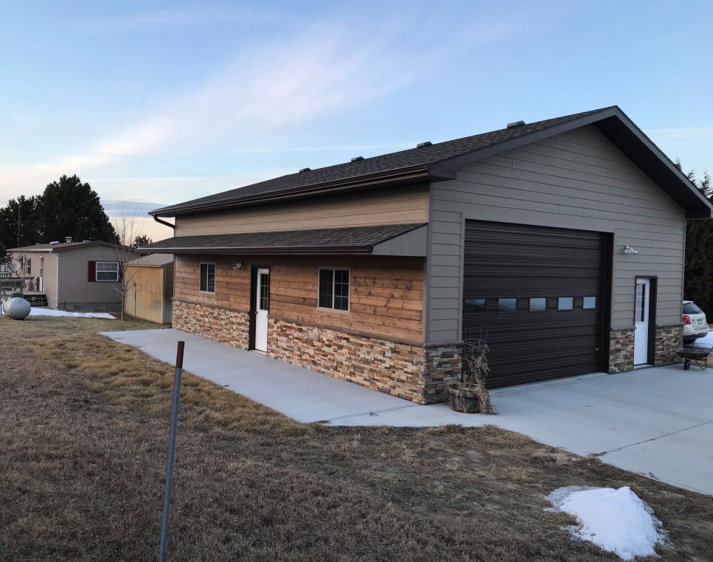
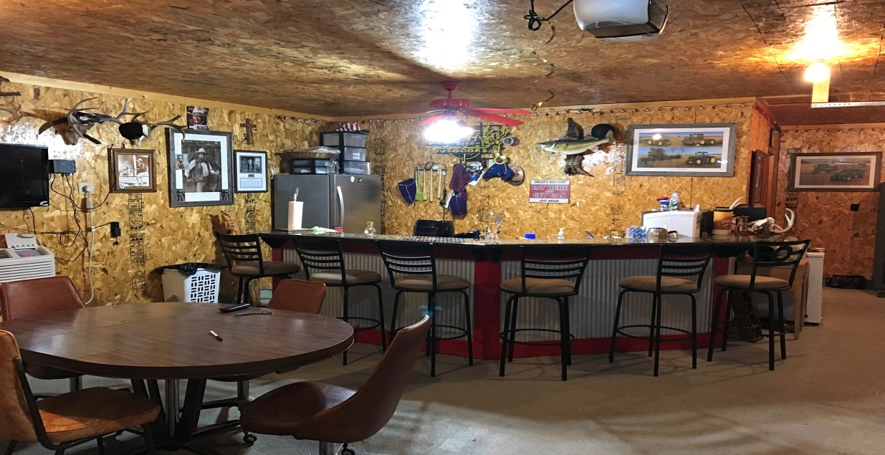
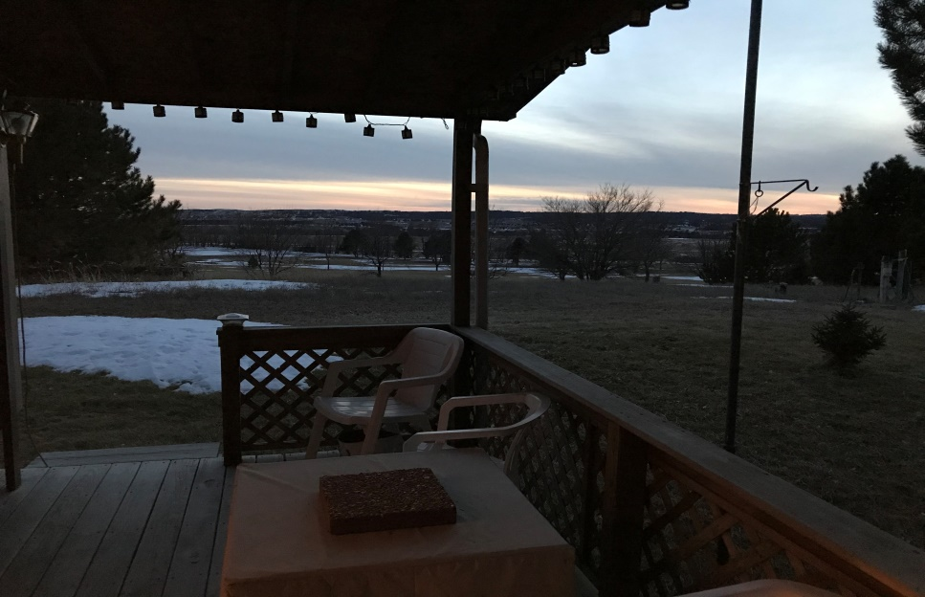
If your looking for a lake get away that has everything you need this cabin is a must look. This property has multiple storage buildings, detached garage, camper hookups, bunk house, wrap around deck, and lots of space and amenities for entertaining. Underground sprinklers offer a low maintenance lush yard even throughout those hot summer months. The large deck offers amazing evening views. Come take a look at this extremely versatile property before its gone. Rick Foxworthy 402-760-1100
82685 GROUSE LANE BURWELL, NEBRASKA
Cabin Realty & Ag Services, Inc.
Real Estate Sale & Management
Michele Usasz-Wells, Broker
Office: 308-346-4425
www. CabinRealtyAgServices.com

