Slide 1
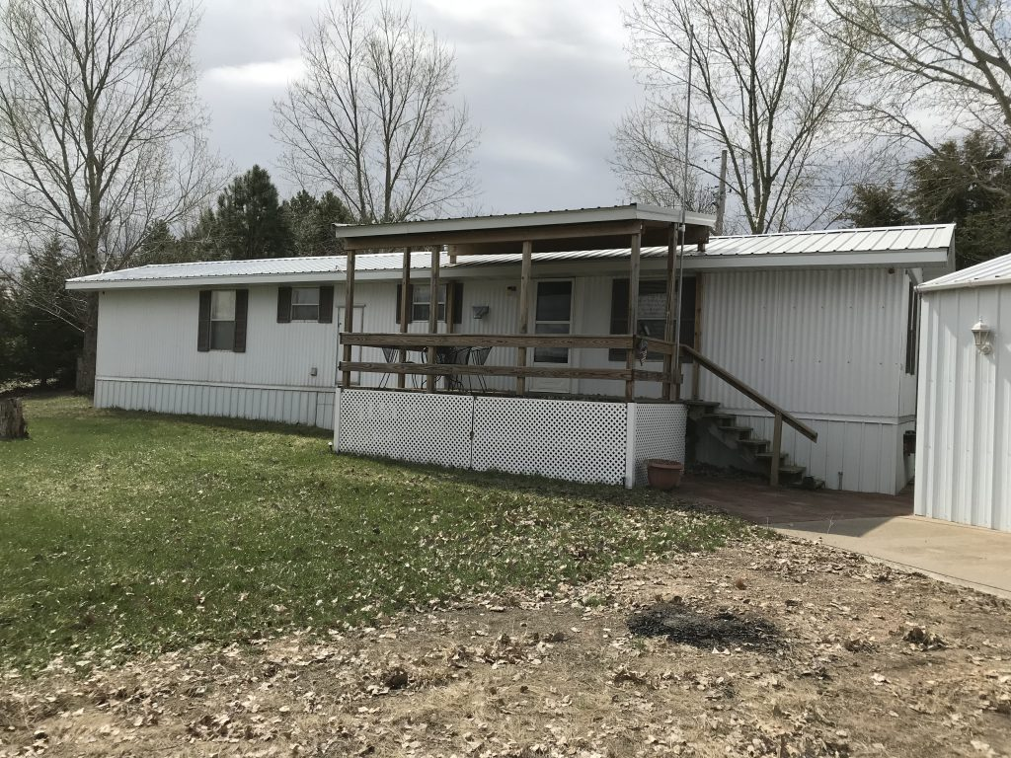
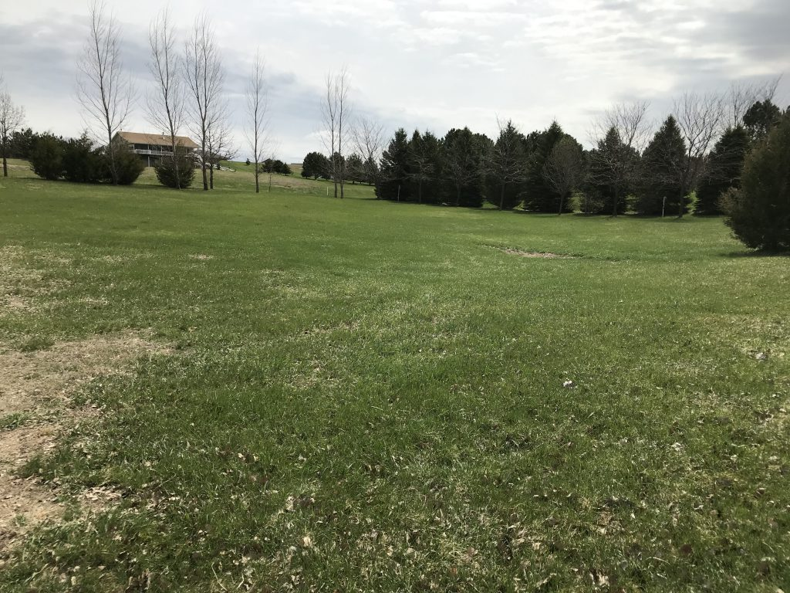
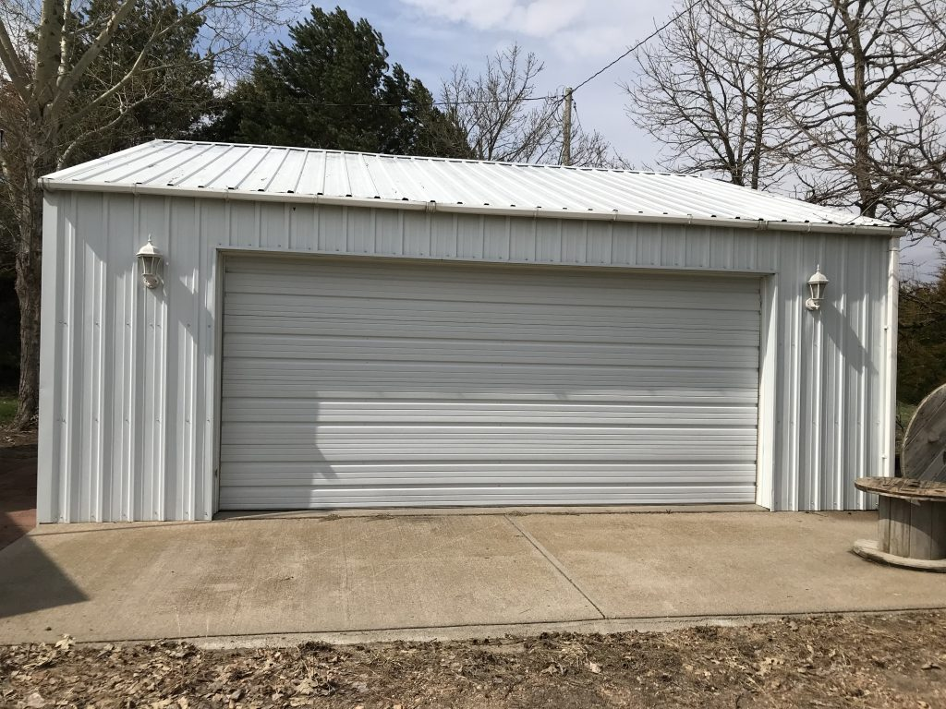
This lake property is located on 1.05 acres of the luxurious Calamus Country Acres adjacent to Calamus Golf Course. If you are looking to store your boat, plug in campers, put up guests, or entertain in your yard you can find it all right here. Addition to the 3 bedrooms offered in the house, a bunk house offers sleeping space and privacy for your guests. Start enjoying the Calamus lifestyle with your family and friends. Let us show you the POSSIBILITIES! * Broker Owned Rick Foxworthy 402-760-1100
82749 GROUSE LANE, BURWELL, NE
Cabin Realty & Ag Services, Inc.
Real Estate Sale & Management
Michele Usasz-Wells, Broker
Office: 308-346-4425
www. CabinRealtyAgServices.com

