Slide 1
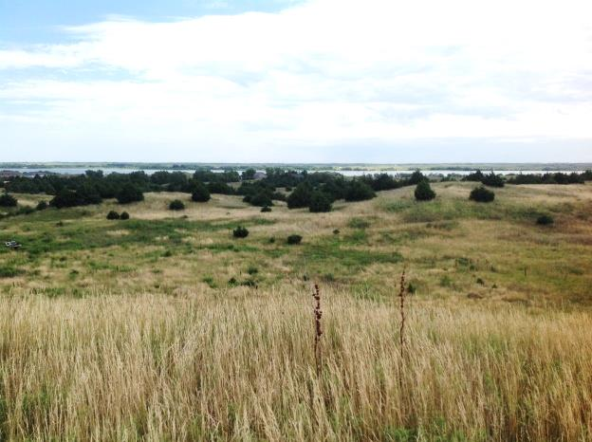
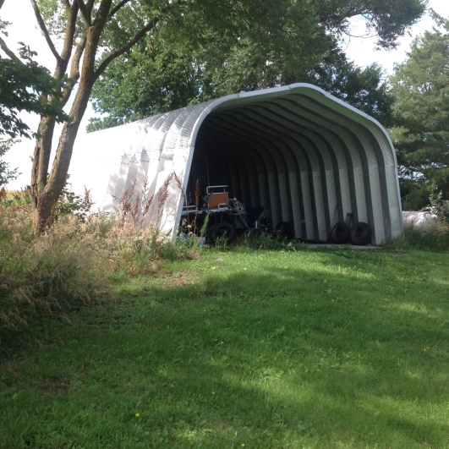
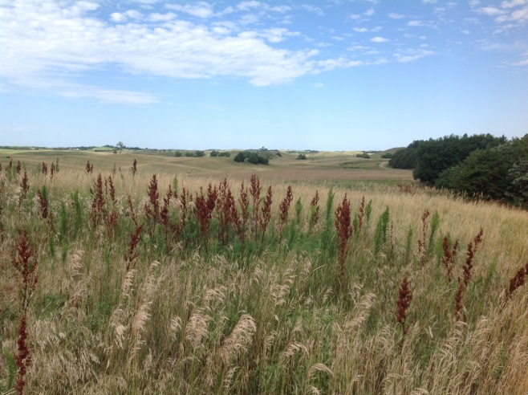
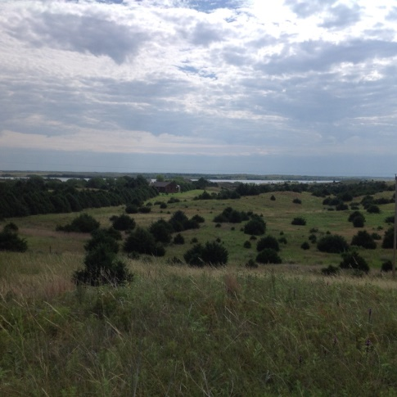
Legal Description: A tract of land in the W1/2 of the NW1/4 of the SE1/4 of Section 27- Township 22N- Range 17W of the 6th P.M., Loup County, NE List Price: $210,000.00 – Make an offer Real Estate Taxes: 2017 - $398.04 Contact: Michele Usasz 308-750-0522 Comments: A chance to purchase an acreage near the Calamus not restricted by the covenants of a subdivision, with great views of the lake. This acreage consists of 19.9 +/- acres approximately 1.5 miles from the Calamus Lake.
82928 460th Ave. – Burwell, NE
Cabin Realty & Ag Services
Real Estate Sale & Management
Michele Usasz, Broker
Terry K. Held, Associate Broker
Office: 308-346-4425
www. CabinRealtyAgServices.com

