Slide 1
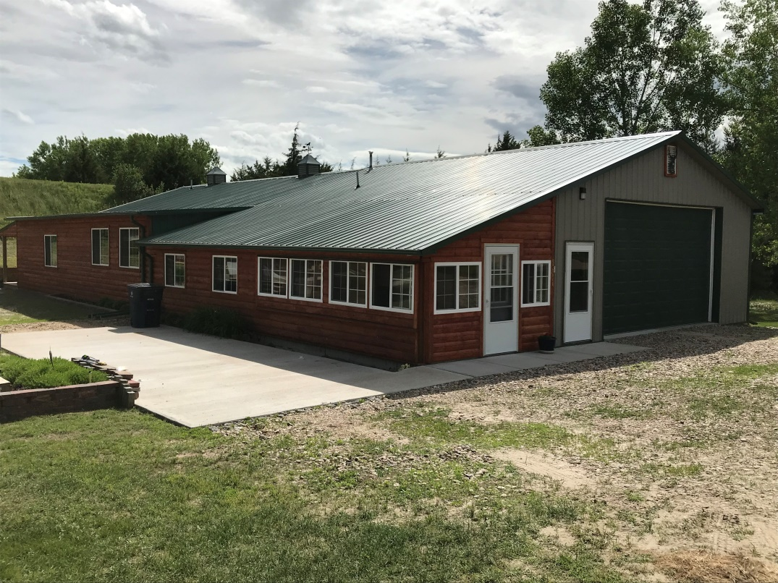
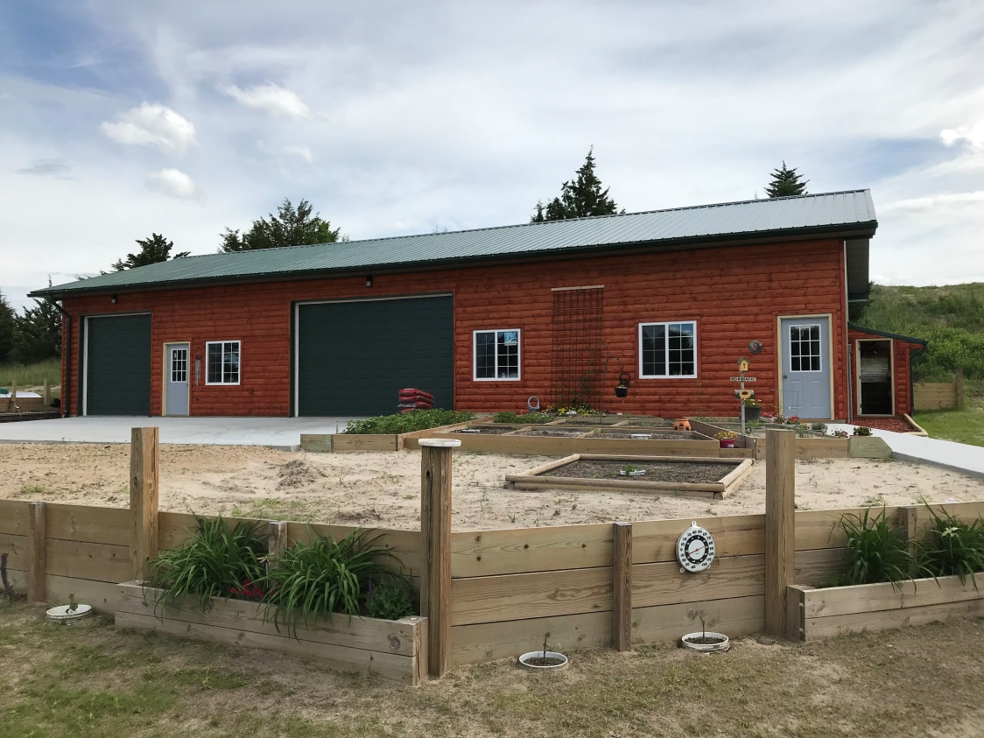
This Calamus Lake property has been custom built with meticulous care and expertise. Storage space, work space, living space, landscaping, drainage, functionality, simplicity, cooling/ heating, future repair/remodeling, and future lot developments have all been infused throughout every design that has been applied to this Mike's Meadows tract. The home offers 2 bedrooms, 3 bathrooms, custom built wood-working throughout the nearly 2,000 sq. ft. living area. Sitting on 1.73 acres supplies extra room if expansion is ever desired. Estates with this much diversity do not come up for sale very often and will not stay on the market long. Copies of covenants and restrictions available upon request. Call for your private showing! Erik Schwager 308-750-0345
83071 Walleye Way
Calamus Lake
Burwell, NE
Cabin Realty & Ag Services, Inc.
Real Estate Sale & Management
Michele Usasz-Wells, Broker
Office: 308-346-4425
www. CabinRealtyAgServices.com

