Slide 1
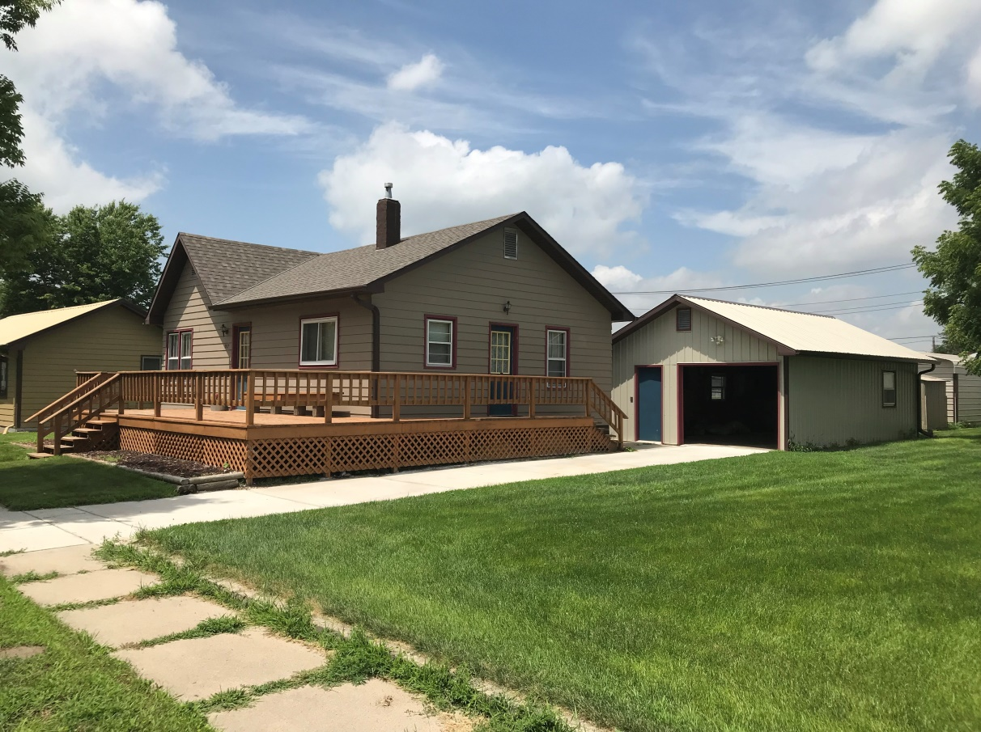
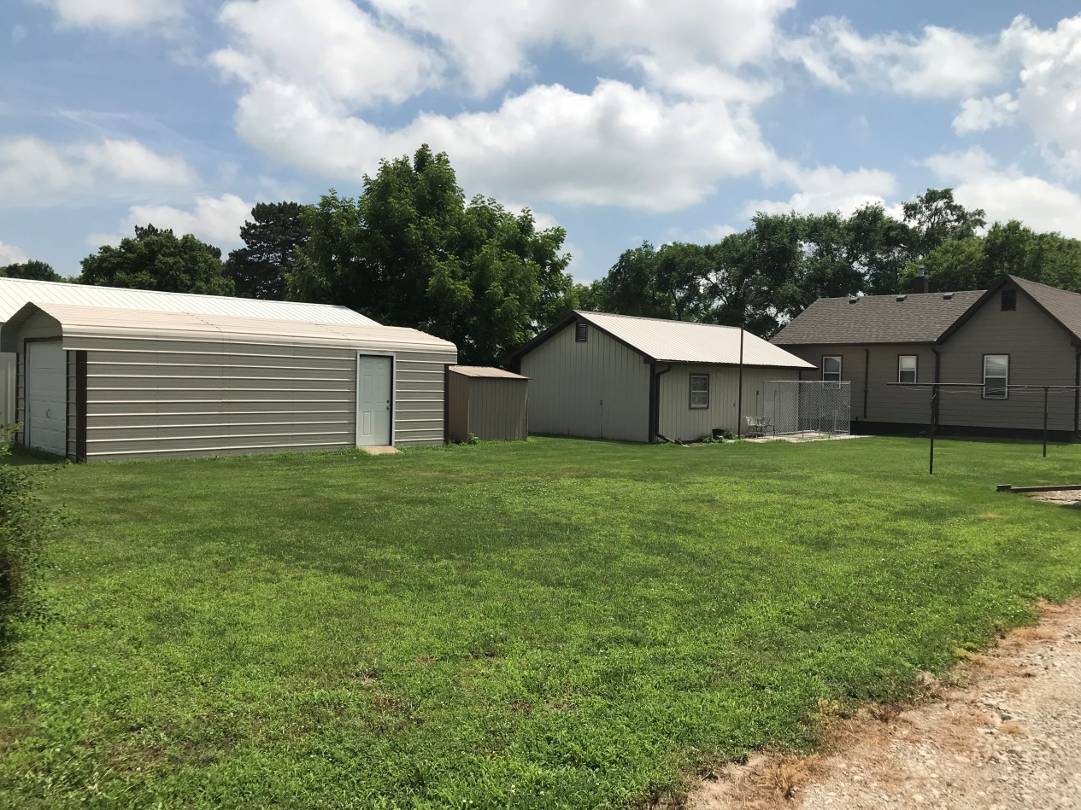
927 F. Street Burwell, NE
Complete Remodel in 1996
Recent Updates
Roof, Paint, Driveway, Etc.
Michele Usasz-Wells
308.750.0522
Cabin Realty & Ag Services, Inc.
Real Estate Sale & Management
Michele Usasz-Wells, Broker
Office: 308-346-4425
www. CabinRealtyAgServices.com

