Slide 1
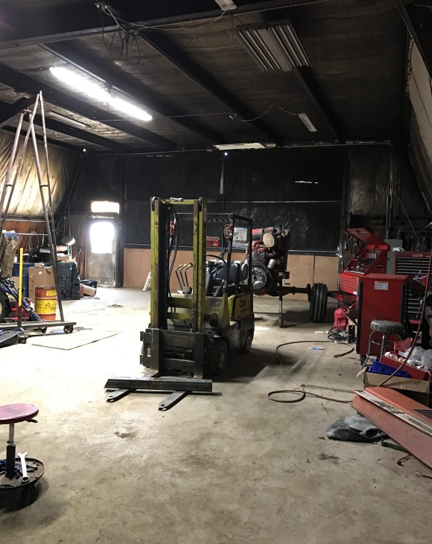
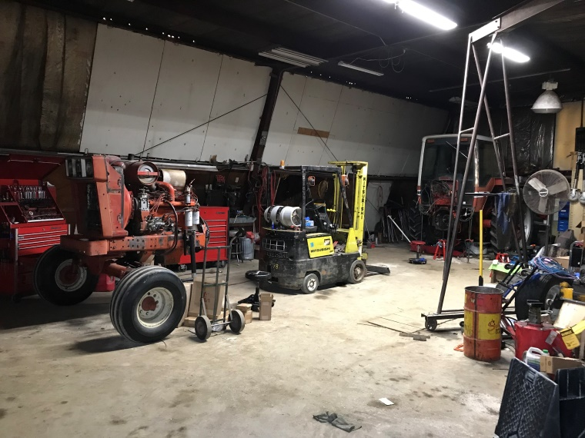
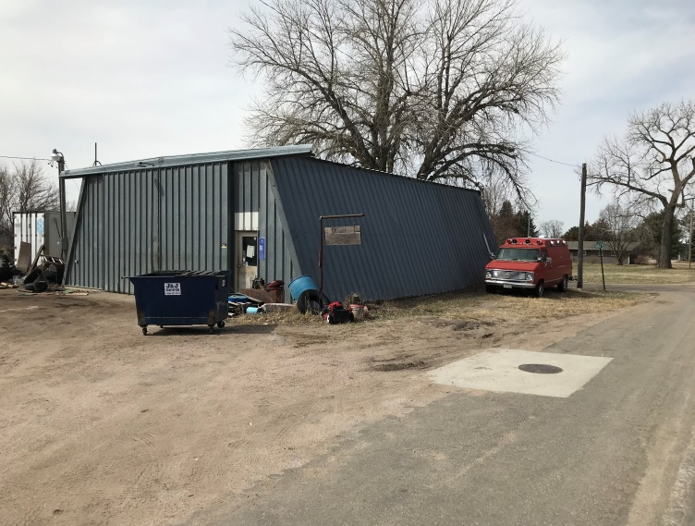
N 40' Lot 11& Lots 12-14, Block 6, West Addition, to the City of Bassett, Rock County, NE Contact: Rick Foxworthy - 402.760.1100 This commercial property offers multiple lots with a corner lot offering street access from 2 sides. A 38' by 48' metal shop is set up for your business head quarters. Building has water, sewer, phone, office space, electrical 110v & 220v, propane heating, air conditioning, overhead lighting, and attached storage space.
Shop & Commercial Lots
Bassett, NE
Cabin Realty & Ag Services
Real Estate Sale & Management
Michele Usasz, Broker
Terry K. Held, Associate Broker
Office: 308-346-4425
www. CabinRealtyAgServices.com

