Slide 1
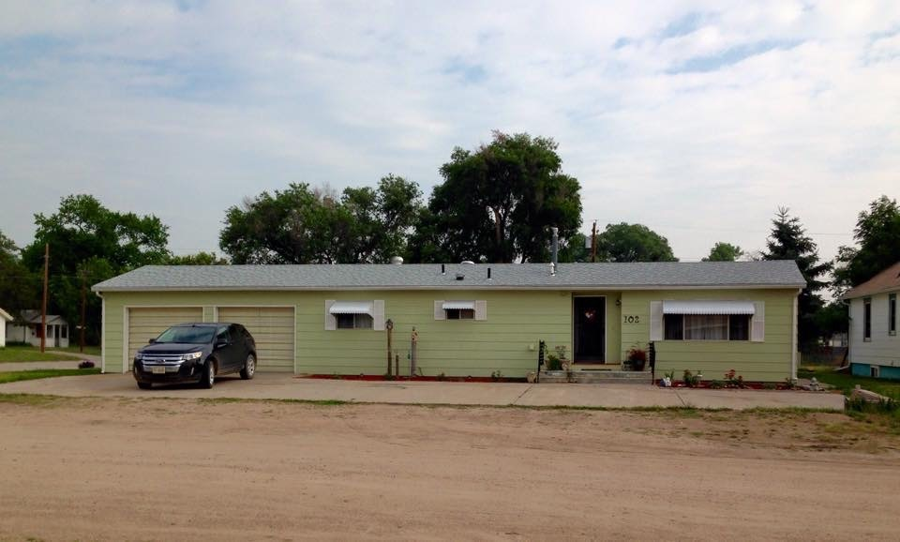
102 EAST AVE I, OSHKOSH, NE
3 Bedroom - 1 Bath - Ranch Style Home
Attached Garage & Appliances!
Excellent Location & Corner Lot!
Christy Underwood 402-669-6149
Cabin Realty & Ag Services, Inc.
Real Estate Sale & Management
Michele Usasz-Wells, Broker
Office: 308-346-4425
www. CabinRealtyAgServices.com

