Slide 1
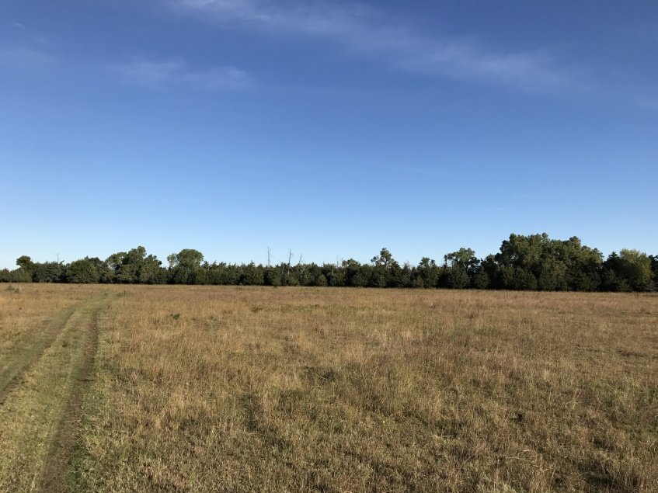
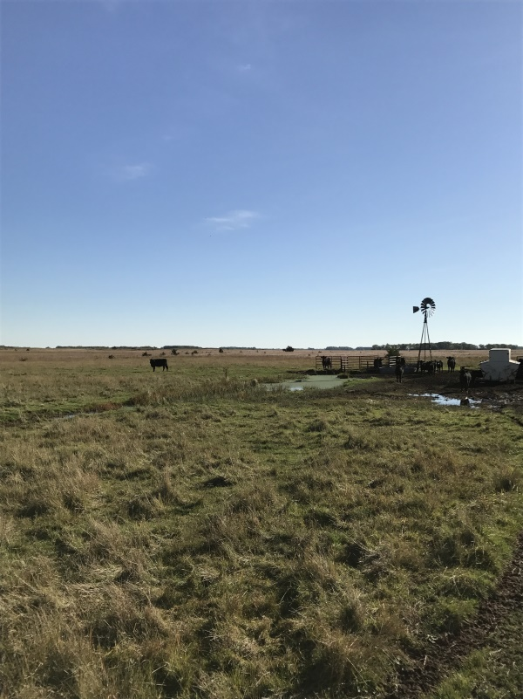
321+/- ACRES, ALL GRASS UNIT, HOLT COUNTY, NEBRASKA
Location: This property is located 9 miles west of Chambers on HWY 95 and 2 miles south on 478th Avenue to the northwest corner of the subject property marked by Cabin Realty & Ag Services sign.
This is an all grass unit that runs 50 pair for the 5 month grazing season. This parcel has good county road access along the western border. A single well is centrally located in the grazing unit.
PRICE REDUCED!!!
Contact:
Rick Foxworthy 402.760.1100
Office: 308.346-4425
www.CabinRealtyAgServices.com
Cabin Realty & Ag Services
Farm & Ranch Real Estate & Management
Burwell, Nebraska
Michele Usasz, Broker
Terry K. Held, Associate Broker

