Slide 1
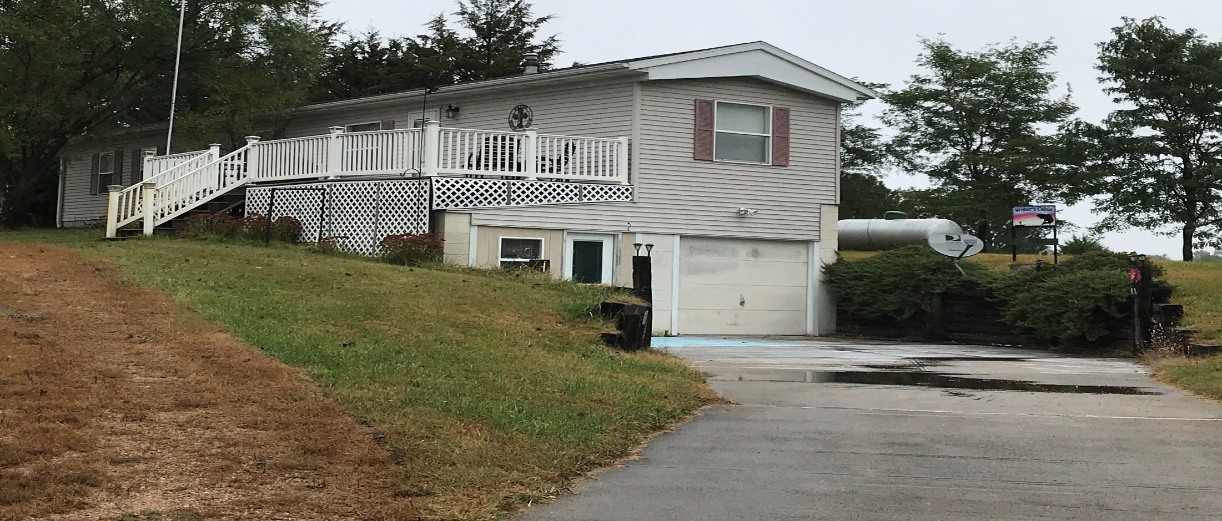
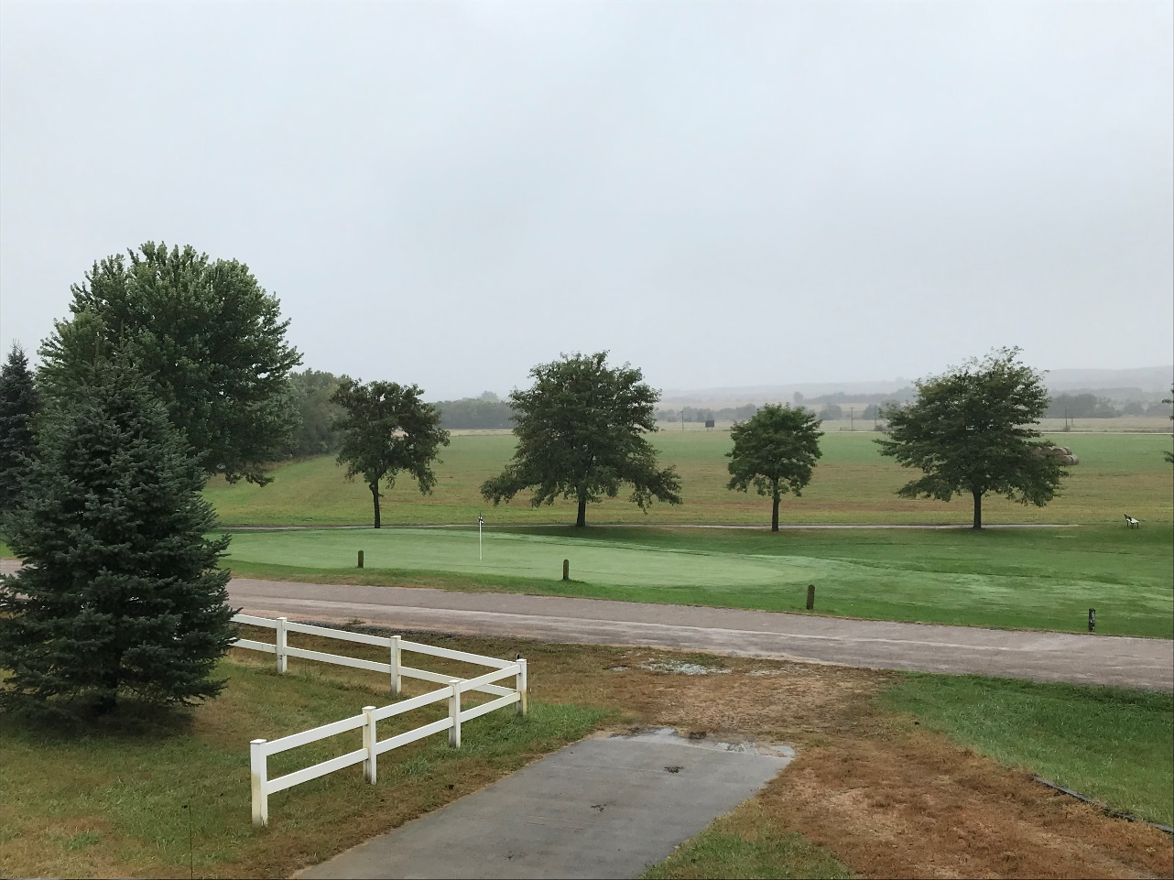
-Calamus Lake & Golf Course- -2 Lots- -Camper Amenities- -Fully Furnished- Rick Foxworthy 402-760-1100
82762 White Tail Lane, Burwell, NE
Cabin Realty & Ag Services, Inc.
Real Estate Sale & Management
Michele Usasz-Wells, Broker
Office: 308-346-4425
www. CabinRealtyAgServices.com

