Slide 1
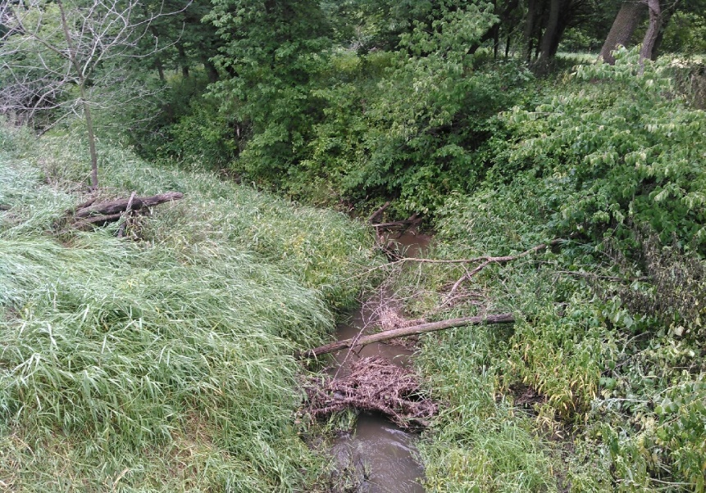
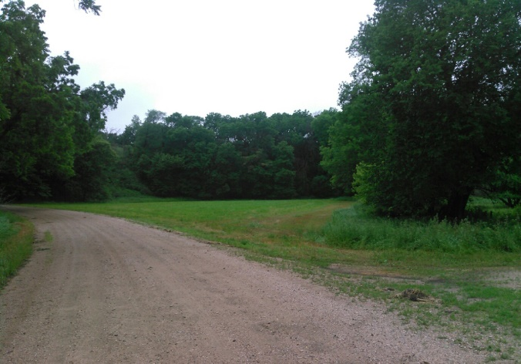
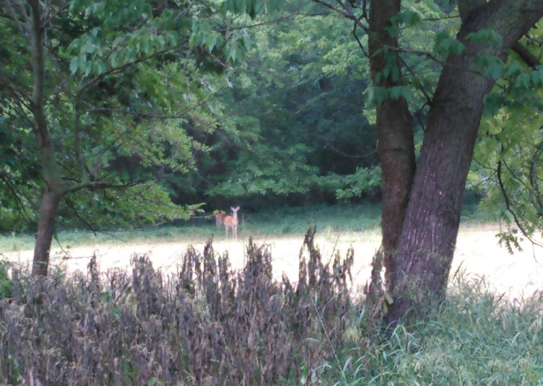
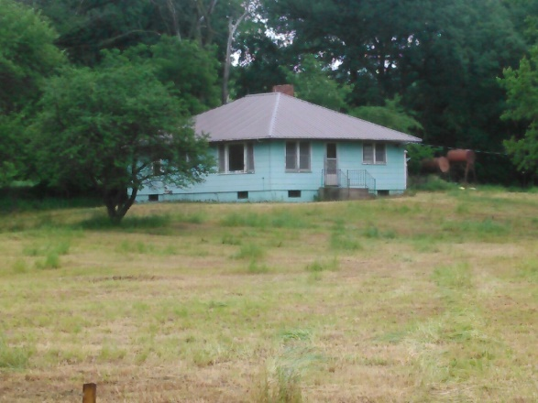
40.82 +/- ACRES, knox COUNTY, NE
Location/Description:
Driving directions from Center, NE. Take 881st Rd Southwest for approx. 2 1/2 miles. Subject property is marked by Cabin Realty & Ag Services sign.
Here is your opportunity to own a VERY sought after Knox County hunting property. This 40 +/- acre tract offers a building site, 2 creeks offering running water, hardwood bottoms containing mostly oak and walnut. 2018 grazing lease available to purchaser. Schedule a showing of this beautiful property before its to late!
Contact:
Mike Kumm 402.394.1118
Office: 308.346-4425
www.CabinRealtyAgServices.com

