Slide 1
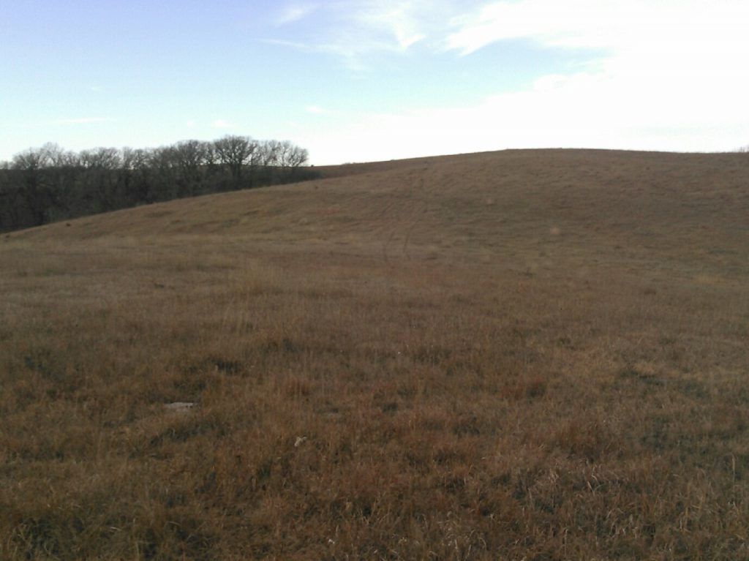
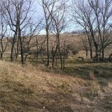
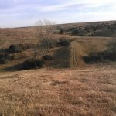
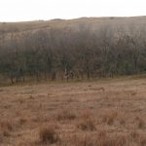
Legal Description: The Southeast Quarter of the Northeast Quarter of Section 18, Township 30, Range 5 of the 6th P.M., Knox County, Nebraska. Location/Description: From Winnetoon, NE : Go east of Winnetoon on 875th Rd to 528th Ave, turn onto 528th Ave. Follow 528th Ave north for 4 miles to 879th Rd. Turn East on 879th Rd & follow approximately 3/4 of a mile. Turn north and follow to dead end marked by Cabin Realty and Ag Services Sign. Comments: This property's location offers seclusion and privacy for hunting purposes. Cedar trees have been removed to better utilize the grazing unit. It has grass units on 3 sides and crops on 1 side adding to the wildlife activity.
40+/- Acres – All Grass Unit with Recreational Potential
Knox County, NE
List Price: $105,000.00 Real Estate Taxes: 2017 - $528.00 Contact: Mike Kumm 402.394.1118
Cabin Realty & Ag Services
Real Estate Sale & Management
Michele Usasz, Broker
Terry K. Held, Associate Broker
Office: 308-346-4425
www. CabinRealtyAgServices.com

