Slide 1
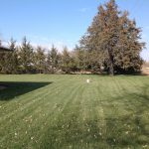
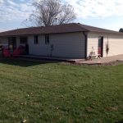
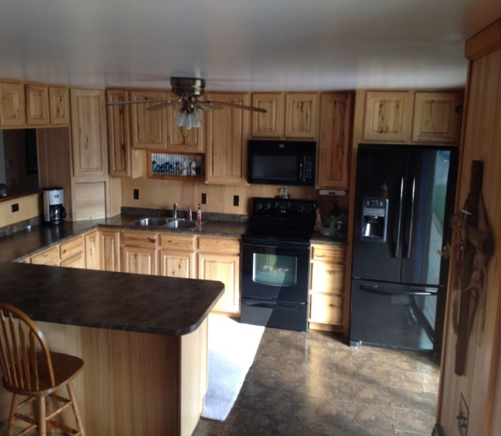
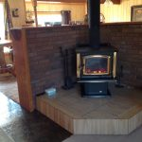
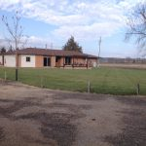
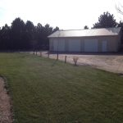
Location/Description: This acreage is located less than one mile north of Burwell List Price: $219,000.00 Real Estate Taxes: 2016 $1,465.88 Contact: Rick Foxworthy 402.760.1100 Here is your chance to purchase a very well kept property on the outskirts of town, all while being close enough to enjoy the amenities of Burwell. This 2,028 sq ft house is all electric, with 3 bedrooms, 2 bathrooms, wood burning fireplace, and a 1,320 sq ft garage. In 2010 a deck was added to the front and back of the house, with a walk joining the two sides. In 2012 the kitchen was updated and all new hickory cabinets were installed, there were also new windows, patio doors and underground sprinkles added. The roof is brand new in 2016!
82540 Windy Hill Avenue, Burwell, NE
Cabin Realty & Ag Services
Real Estate Sale & Management
Michele Usasz, Broker
Terry K. Held, Associate Broker
Office: 308-346-4425
www. CabinRealtyAgServices.com

